Slide 1
Fine-mapping and examples of data integration
HUGEN 2073
Jon Chernus

Slide 2
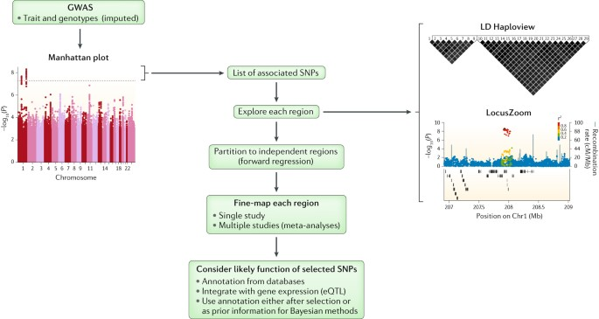
Fine-mapping
“Fine-mapping seeks to determine the genetic variant (or variants) responsible for complex traits, given evidence of an association of a genomic region with a trait and assuming at least one causal variant exists. ”
Notes:
Suggested reading:
https://www.nature.com/articles/s41576-018-0016-z

Slide 3
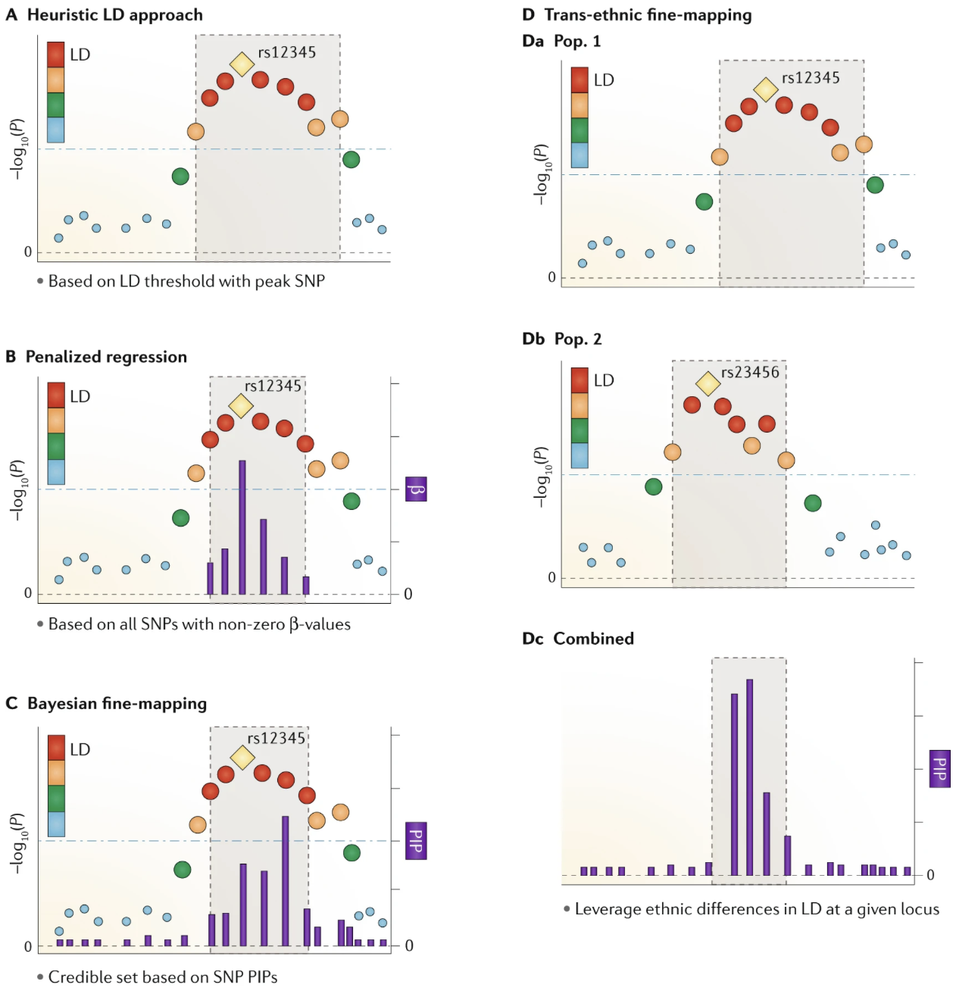
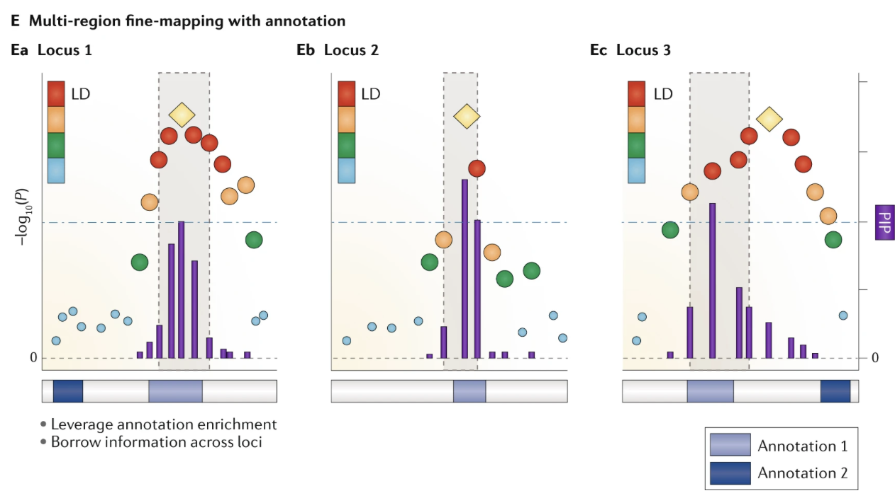
Some fine-mapping strategies
Notes:
All subfigures are based on LocusZoom-style illustrations of marginal single-nucleotide polymorphism (SNP) associations. The –log₁₀ (P) values are presented on the left y axis, and variant positions are on the x axis. The gold diamond for each locus represents the peak SNP. The results for other SNPs are coloured by descending degree of linkage disequilibrium (LD) with the peak SNP (ordered red, orange, green and blue dots).
The purple bars represent additional variant-level statistics produced by fine-mapping (that is, β-values for penalized regression and posterior inclusion probabilities (PIPs) for Bayesian methods), and the corresponding scale is on the right yaxis.
The light grey boxes represent the regions selected by fine-mapping.
A | The heuristic approach is based on LD patterns with the peak SNP (rs12345). All SNPs that meet the orange LD category threshold have been selected.
B | The penalized regression approach selects all SNPs whose effects (β, right axis) are not shrunk to zero.
C | Bayesian fine-mapping produces SNP-level PIPs (right axis), which can be summed to form credible sets on the basis of a specified coverage probability threshold (for example, 95%). This example illustrates that the peak SNP does not correspond to the SNP with the highest PIP, which can occur because of the correlation structure among all SNPs in the region.
D | Bayesian trans-ethnic fine-mapping. Results for the same locus are illustrated for two diverse study populations (Pop. 1 (part Da) and Pop. 2 (part Db)) with different local LD structures. The peak SNPs for the two analyses differ (rs12345 versus rs23456), and combining the results through meta-analysis yields a narrowed fine-mapping credible region (part Dc).
E | Joint analysis of multiple loci by integrating annotation in Bayesian fine-mapping can improve fine-mapping by borrowing annotation information across loci. Presented are three example independent loci (parts Ea, Eb and Ec), along with two corresponding regional annotations, indicated by bands below each locus plot. For loci 1 and 2, the peak SNPs overlap with Annotation 1, indicating enrichment. This enrichment results in the SNP with the highest PIP in locus 3 to be different from the peak SNP in locus 3.

Slide 4
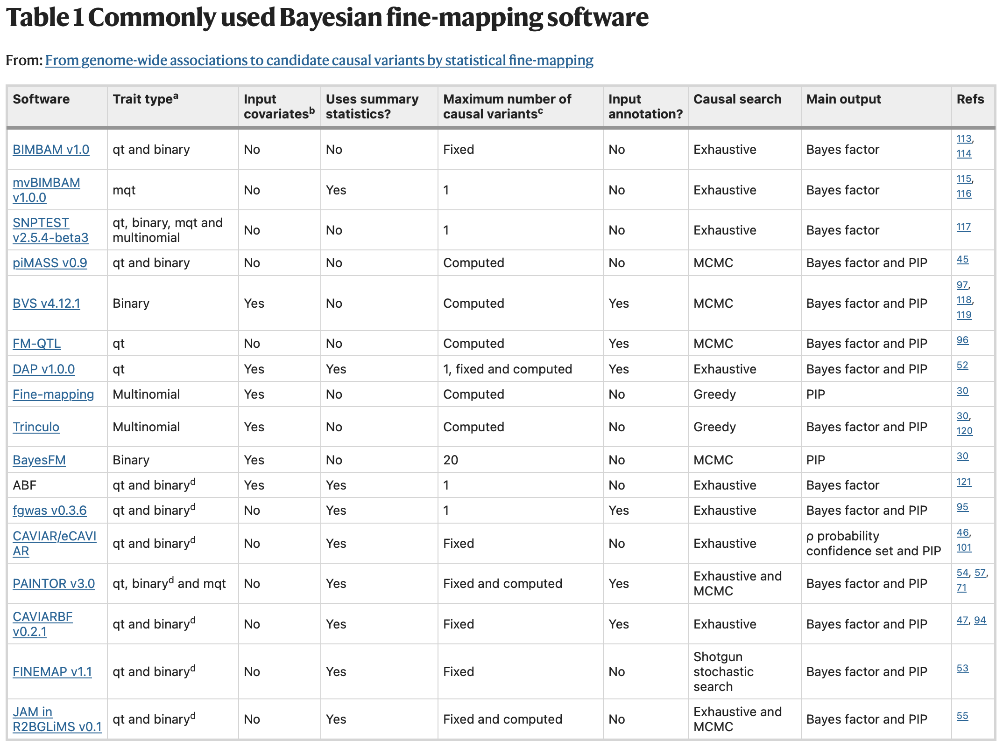
Some fine-mapping tools
Posterior inclusion probability(PIP) = The marginal probability that a single-nucleotide polymorphism (SNP) is included in any causal model, conditional on the observed data, thereby providing weight of evidence that a SNP should be included as potentially causative.
Bayesian methods can be used to determine the credible set, the minimum set of SNPs that contains all causal SNPs with probability α. When assuming only one causal SNP, α is the sum of PIPs for SNPs in a set. This means that an α credible set is equivalent to ranking SNPs from largest to smallest PIPs⁵⁰ and taking the cumulative sum of PIPs until it is at least α.
Another populat tool:
SusieR (R package)

Slide 5
Colocalization
“One approach to understanding the biological basis of these associations has been to explore whether GWAS signals from intermediate cellular phenotypes, in particular gene expression, are located in the same loci (“colocalise”) and are potentially mediating the disease signals. However, it is not clear how to assess whether the same variants are responsible for the two GWAS signals or whether it is distinct causal variants close to each other. In this paper, we describe a statistical method that can use simply single variant summary statistics to test for colocalisation of GWAS signals.” - COLOC
Coloc is a Bayesian method which, for two traits, integrates evidence over all variants at locus to evaluate the following hypotheses:
H0: No association with either trait
H1: Association with trait 1, not with trait 2
H2: Association with trait 2, not with trait 1
H3: Association with trait 1 and trait 2, two independent SNPs
H4: Association with trait 1 and trait 2, one shared SNP
Some other tools:
HyPrColoc
Notes:
Suggested reading/source:
COLOC:
https://journals.plos.org/plosgenetics/article?id=10.1371/journal.pgen.1004383
SusieR:
https://journals.plos.org/plosgenetics/article?id=10.1371/journal.pgen.1009440
HyPrColoc:
https://www.nature.com/articles/s41467-020-20885-8

Slide 6
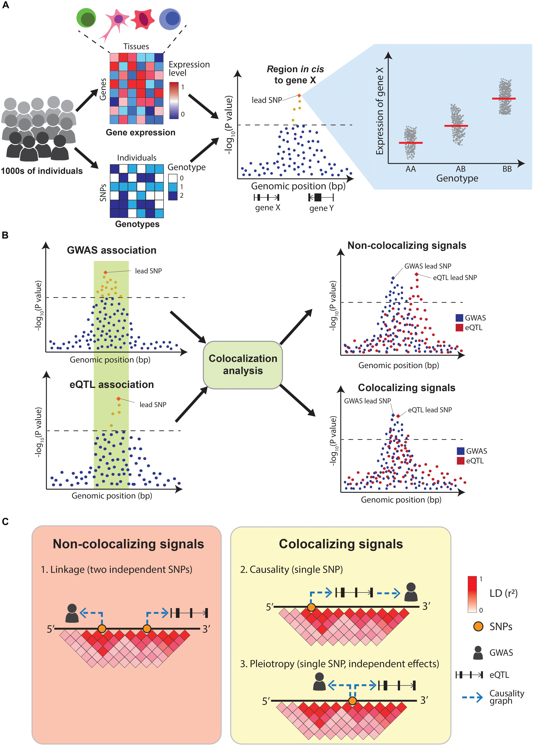
Colocalization
“Overlapping eQTL and GWAS signals can be explained by three possible scenarios:
(1) two independent causal SNPs in LD with each other (linkage)
(2) a single-causal SNP which affects the trait by modulating the expression of a gene (causality), or
(3) a single-causal SNP with independent effects on trait and gene expression (pleiotropy).
Distinguishing between these scenarios is crucial to appropriately interpret GWAS results”
Notes:
https://www.frontiersin.org/files/Articles/505357/fgene-11-00424-HTML/image_m/fgene-11-00424-g003.jpg

Slide 7
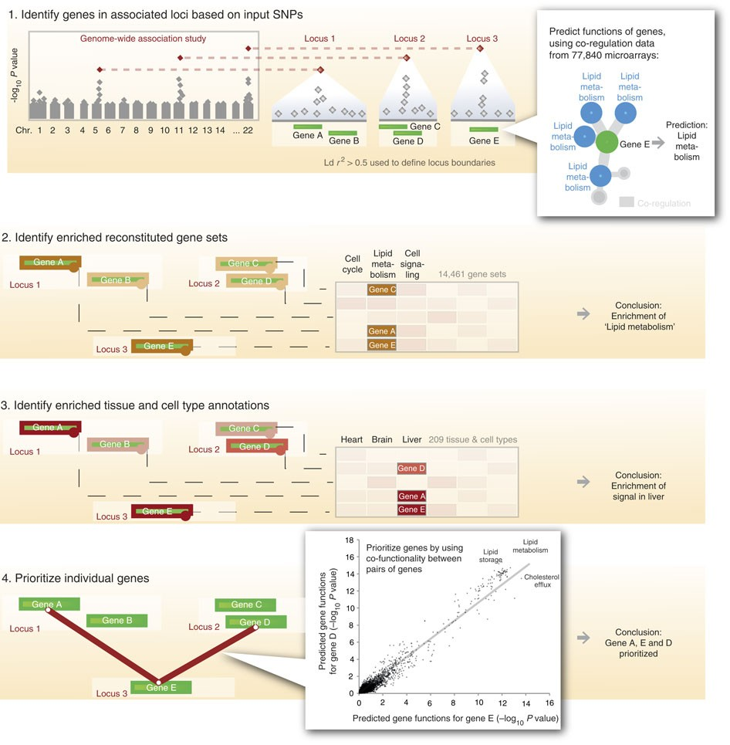
Another tool: DEPICT
DEPICT is designed to identify likely causal genes, functional or phenotypic gene sets that are enriched in genes within associated loci, and tissues or cell types that are implicated by the associated loci. DEPICT takes as input a set of trait-associated SNPs and uses them to identify independently associated loci that may comprise up to several genes. DEPICT uses co-regulation data from 77,840 microarrays to predict genes’ biological functions across 14,461 gene sets representing a wide spectrum of biological annotations and to construct 14,461 ‘reconstituted’ gene sets. DEPICT then uses this information to identify reconstituted gene sets that enrich for genes in the associated loci, and to prioritize genes at associated loci, by identifying genes in different loci that have similar predicted functions. Finally, DEPICT relies on 37,427 human gene expression microarrays to assess whether genes in associated loci are highly expressed in any of 209 tissue/cell type annotations.
Notes:
https://www.nature.com/articles/ncomms6890

Slide 8
GWAS examples
How are the data integration resources and tools we’ve discussed used in real publications?
We’ll look at examples and try to characterize a few GWA studies based on their “downstream” analyses.

Slide 9
GWAS #1
Phenotype: systemic lupus erythematosus (SLE)
Predominantly studied so far in Europeans
This study performs GWAS in Chinese individuals (largely Han) and re-analyzes existing GWAS cohorts
Known population-level differences: non-Europeans have
earlier age-at-onset
higher prevalence
higher risk of renal disease

Slide 10
GWAS #1 follow-up approach: “Focus on population differences”
Wang, Y. F., Zhang, Y., Lin, Z., Zhang, H., Wang, T. Y., Cao, Y., Morris, D. L., Sheng, Y., Yin, X., Zhong, S. L., Gu, X., Lei, Y., He, J., Wu, Q., Shen, J. J., Yang, J., Lam, T. H., Lin, J. H., Mai, Z. M., Guo, M., … Yang, W. (2021). Identification of 38 novel loci for systemic lupus erythematosus and genetic heterogeneity between ancestral groups. Nature communications, 12(1), 772. https://doi.org/10.1038/s41467-021-21049-y
GWAS in cohorts
Meta-analysis in ancestral groups; Replicated/novel associations
Annotation and “heritability enrichment”;
Pathway analysis
“Trans-ancestral” fine-mapping
Other heterogeneity-related analyses
What variants are associated with SLE?
How similar are Chinese and European signals?
What functional categories explain the most heritability? What pathways are the associations enriched for?
At shared (Chinese + European) loci, can we prioritize variants?
Which variants/signals are shared/colocalize? Can population-level differences help explain signals?

Slide 11
GWAS in cohorts

Slide 12
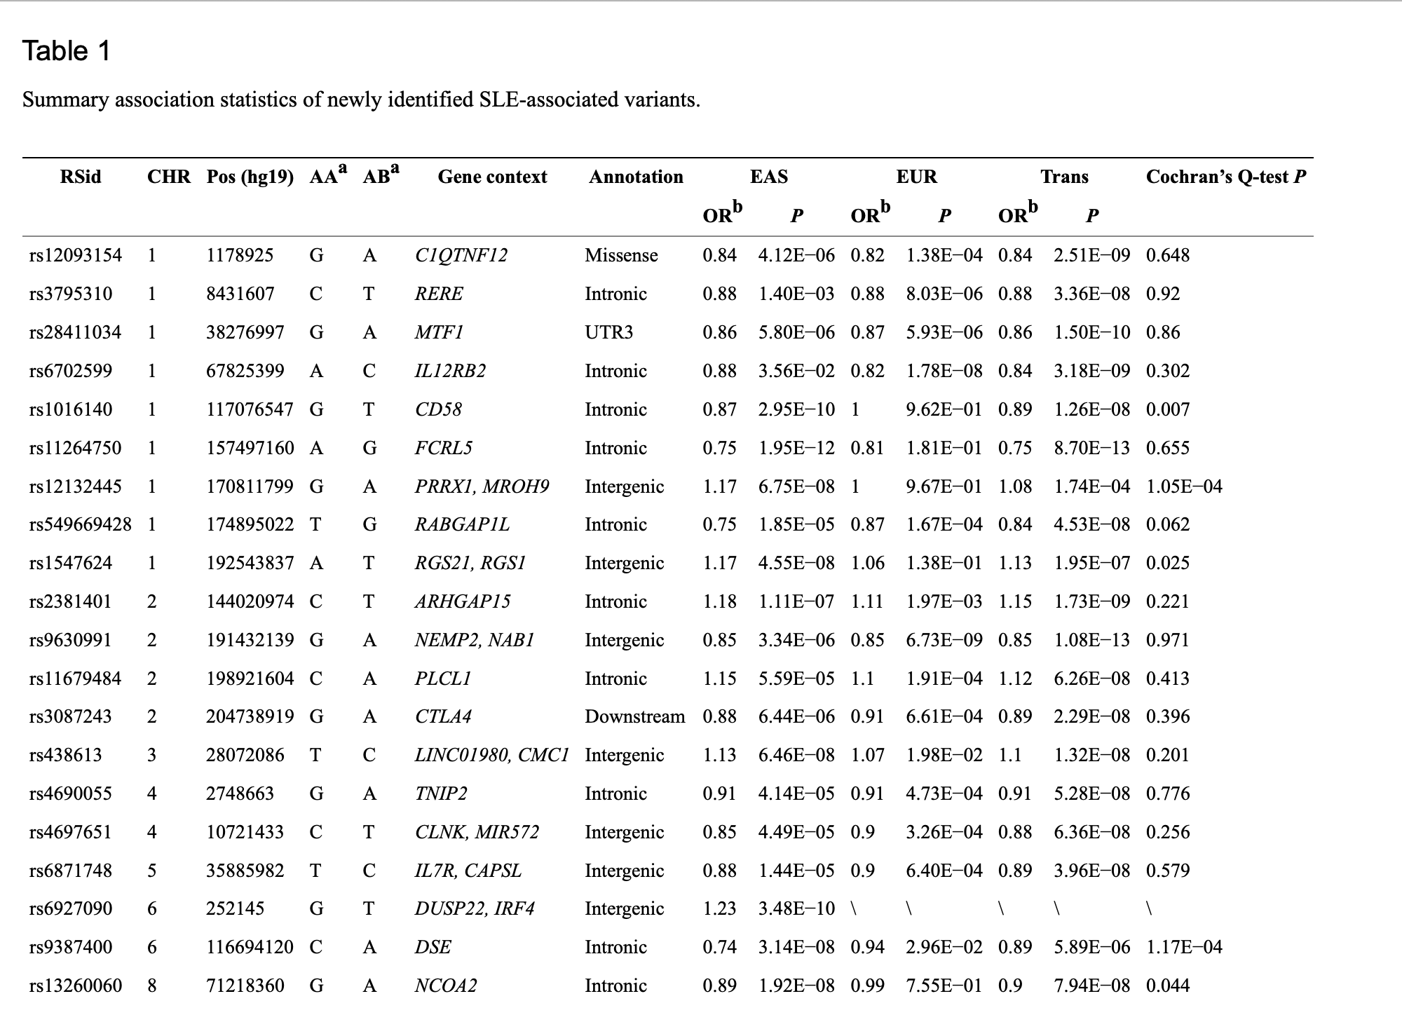
Meta-analysis in ancestral groups

Slide 13
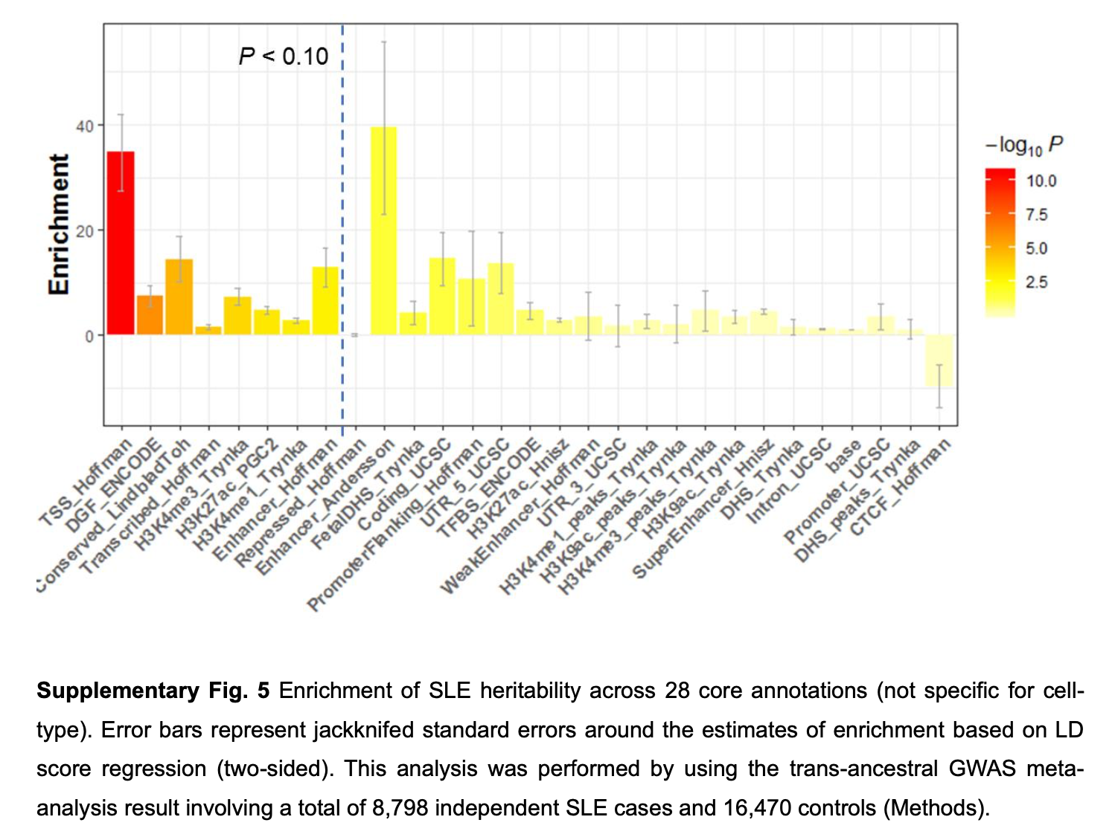
Enrichment of heritability by annotation category (non cell-type-specific)
(LD score regression)
Notes:
Functional annotations that might be enriched with SLE susceptibility loci were evaluated by the stratified LD score regression method²⁴ (see “Methods” section). For non-cell type-specific annotations, heritability was significantly enriched in transcription start sites (P = 2.47E−05), regions that are conserved in mammals (P = 8.22E−03) and ubiquitous enhancers that are marked with H3K27ac or H3K4me1 modifications (P = 4.43E−02, P = 5.03E−02, respectively; Supplementary Fig. ⁵)

Slide 14
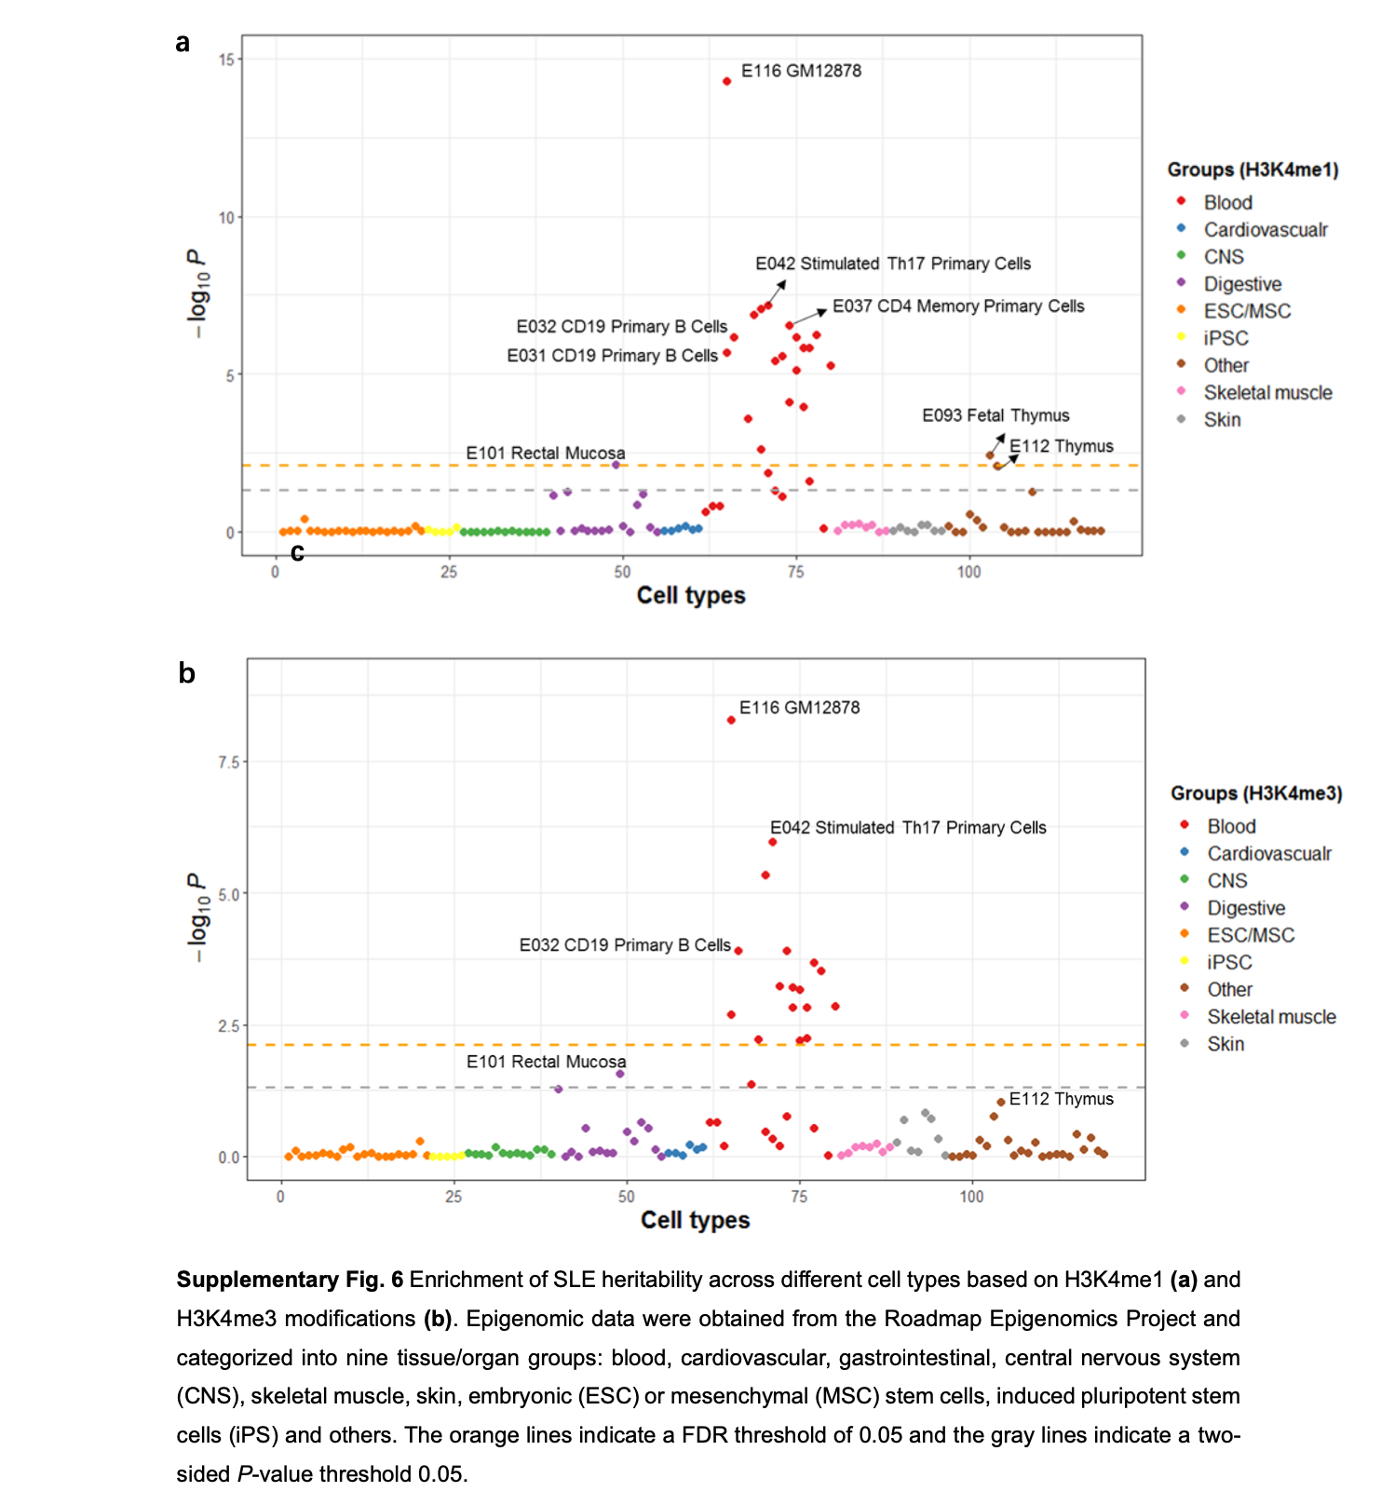
Enrichment of heritability by annotation category (cell-type specific)
(LD score regression)
Notes:
Based on H3K4me1 modifications (associated with active enhancers) across 127 cell types, enrichment of specific cell types was investigated (see “Methods” section). Cells that surpassed the false discovery threshold rate (FDR < 0.05) were mostly hematological cells, with B and T lymphocytes the most prominent cell types associated with SLE (Supplementary Fig. ^{6a}). Similar results were observed based on H3K4me3 modifications (associated with promoters of active genes) (Supplementary Fig. ^{6b}).

Slide 15
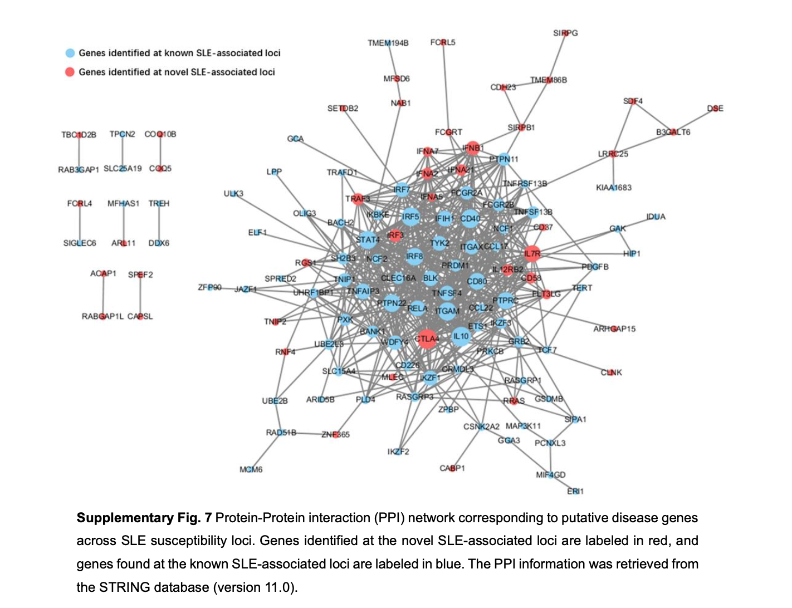
Protein-interaction analysis
A significant level of protein-protein connectivity corresponding to genes found at the novel loci and known SLE-associated loci was observed (P < 1E−16; Supplementary Fig. ⁷; see “Methods” section)

Slide 16
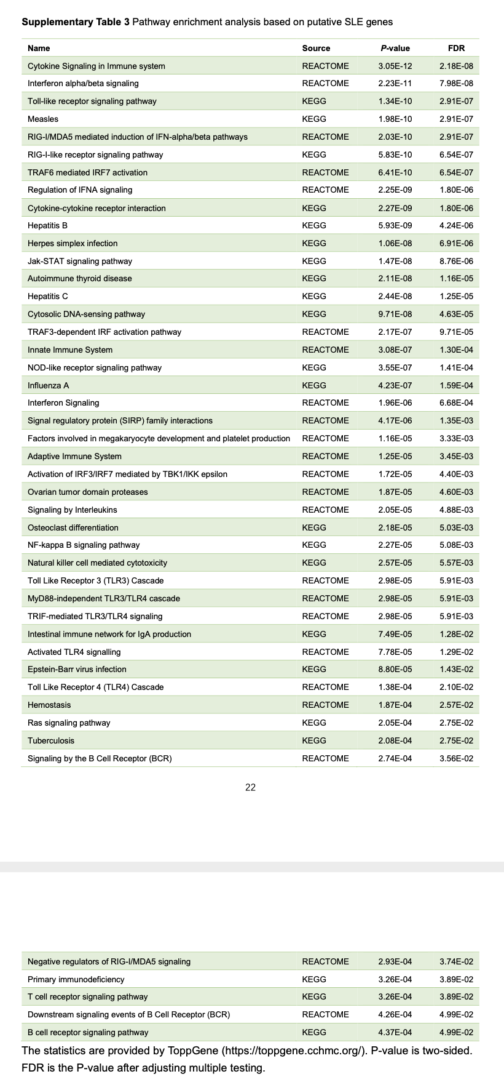
Pathway (gene set) analysis
Forty-five pathways were significantly enriched with these putative SLE susceptibility genes (ToppGene²⁷, FDR < 0.05; Supplementary Table ³)
DEPICT was used to nominate putative causal genes.
Gene sets included KEGG, Reactome, and mouse knockout databases.

Slide 17
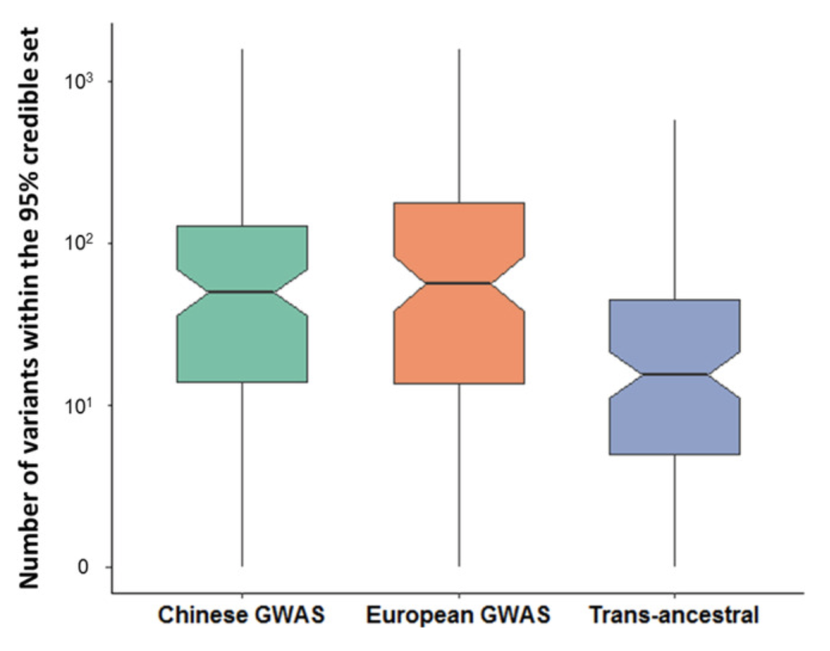
Trans-ancestral fine-mapping
Fine-mapping across 108 SLE-associated loci based on the association results from the Chinese SLE GWAS, the European GWAS, and the trans-ancestral meta-analyses. The Y-axis indicates the number of potential causal variants at each locus based on the 95% credible sets of the association results
(Fine-mapping done with PAINTOR)
Takeaway: trans-ethnic meta-analysis results appear to help with prioritization (smaller credible set when combing LD across two populations)
“A single putative causal variant was identified for the WDFY4 and TNFSF4 loci, the latter of which was functionally validated in a previous study”

Slide 18
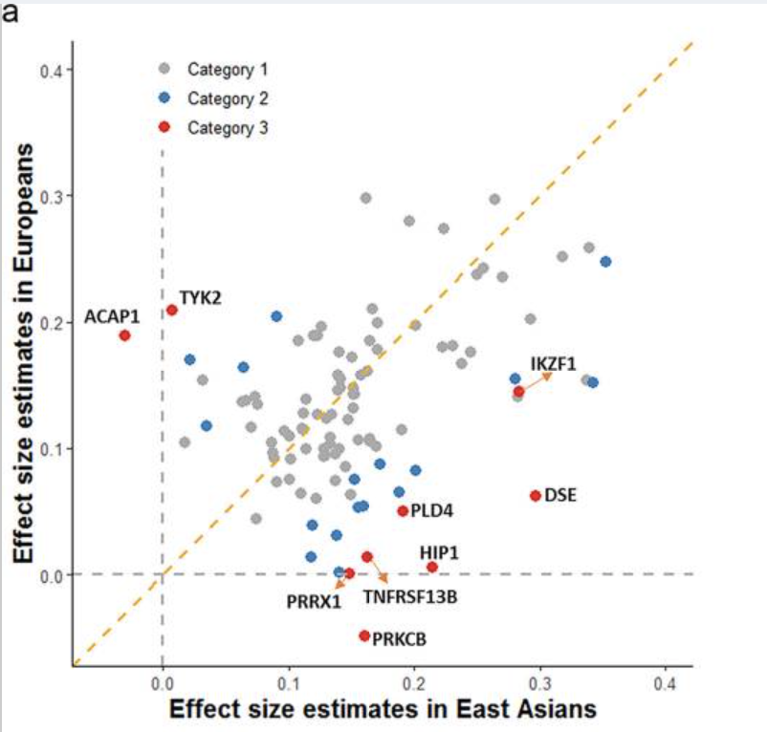
Exploration of heterogeneity
Based on the analysis of Cochran’s Q (CQ)-test that assesses heterogeneity of effect-size estimates from different ancestral groups, SLE-associated variants or loci outside of the HLA region were divided into four categories: (1) ancestry-shared disease loci tagged by variants with CQ-test P ≥ 0.05; (2) putative ancestry-heterogeneous disease loci with CQ-tests of P < 0.05 but FDR adjusted CQ-test P ≥ 0.05; (3) ancestry-heterogeneous disease loci with FDR adjusted CQ-test P < 0.05; and (4) disease loci tagged by associated variants with the risk allele absent in one of the two ancestries
Only loci with MAF > 1% in both populations included
“The ancestry-heterogeneous loci appear to be enriched for functions related to antibody production.”
Literature search for the 9 ancestry-heterogeneous loci (red dots) in human/mouse
Notes:
a Correlation of effect-size estimates for SLE between East Asian (X-axis) and European (Y-axis) populations (r = 0.58, two-sided P-value = 6.52E−11). Disease-associated variants with FDR adjusted CQ-test P-value <0.05 (category 3) are labeled in red, and the variants with CQ-test P-value < 0.05 but FDR adjusted CQ-test P-value ≥0.05 (category 2) are labeled in blue.

Slide 19
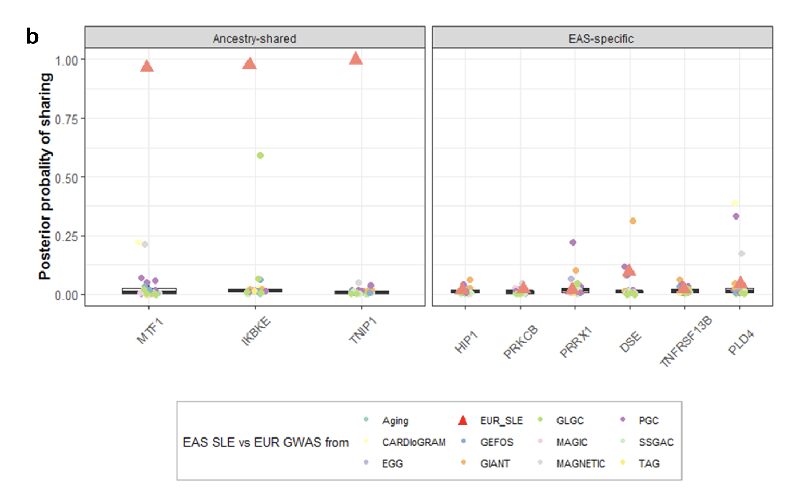
Exploration of heterogeneity
COLOC was used to study colocalization of the European and Chinese associations.
Colocalization methods consider many SNPs, rather than only the leading variant in a locus, to compare association signals between ancestral groups. The ancestry-shared disease loci showed much higher posterior probabilities (PP) of colocalization (mean of PP = 0.42) than the ancestry-specific loci.
Supplementary Fig. 11 b, Red triangles represent the posterior probability of SLE association signals between East Asian and European ancestries. Other symbols represent the colocalization of Chinese SLE association signals with those in European populations for 27 phenotypes unrelated to immunity.

Slide 20
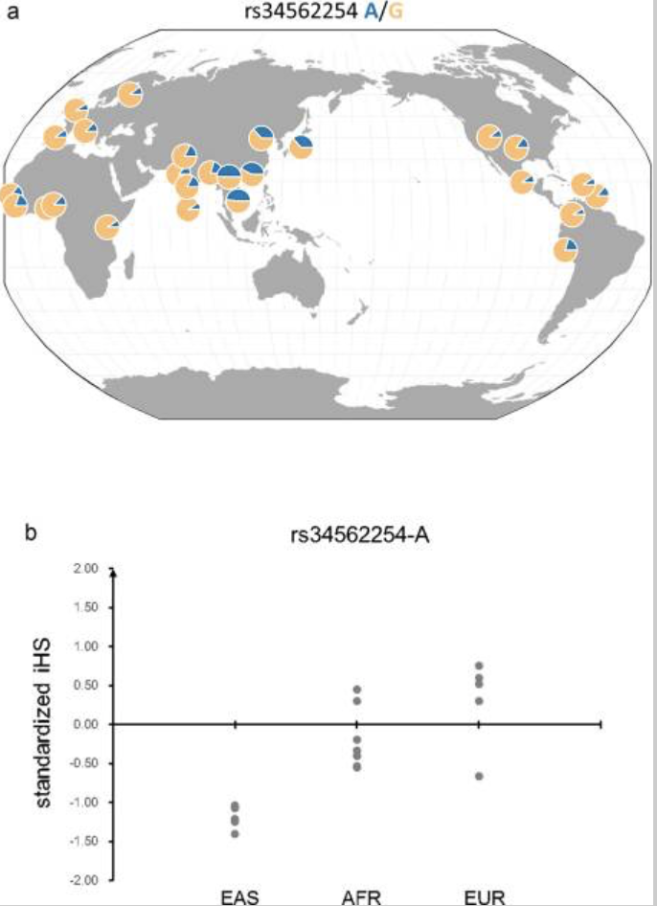
Exploration of heterogeneity
Risk allele frequency and standardized integrated haplotype scores (iHS) across different populations for the Asian-specific variant at TNFRSF13B locus [iHS = measure of positive selection].
→ Suggests recent positive selection for the risk allele in East Asians.
a Frequency for the risk allele rs34562254-A across populations.
b Standardized iHS for the variants across different continental populations (EAS: East Asians; AFR: Africans; EUR: Europeans). The risk allele rs34562254-A is a derived allele, and negative iHS value indicates that the haplotypes carrying the derived allele are longer than the haplotypes carrying the ancestral allele. The frequency and iHS were calculated using data from the 1000 Genomes Project.
BAFF (TNFSF13B) and its receptors, one of which is TACI (TNFRSF13B), play essential roles in B cell survival and differentiation
“Adaptation of the host to resist pathogens may underlie some of the ancestral group-heterogeneity”

Slide 21
GWAS #2 follow-up approach: focus on shared genetics with another trait
Zhou W, Brumpton B, Kabil O, et al. GWAS of thyroid stimulating hormone highlights pleiotropic effects and inverse association with thyroid cancer. Nat Commun. 2020;11(1):3981. Published 2020 Aug 7. doi:10.1038/s41467-020-17718-z
https://www.ncbi.nlm.nih.gov/pmc/articles/PMC7414135/
Genome-wide meta-analysis of thyroid stimulating hormone levels (TSH) discovers 74 loci (some novel);
Gene-based test (rare variant burden)
Fine-mapping & conditional analysis to find potentially causal variants; functional study of a fine-mapped gene
Gene/pathway/tissue prioritization analyses using DEPICT
PheWAS
Polygenic risk score
Mendelian randomization
What loci are associated with TSH?
Can variants be prioritized? Validated functionally?
Are particular genes, gene sets, or pathways implicated?
Are TSH loci associated with other phenotypes?
Can TSH risk also predict risk of other phenotypes?
Is there a causal relationship between TSH and thyroid cancer?

Slide 22
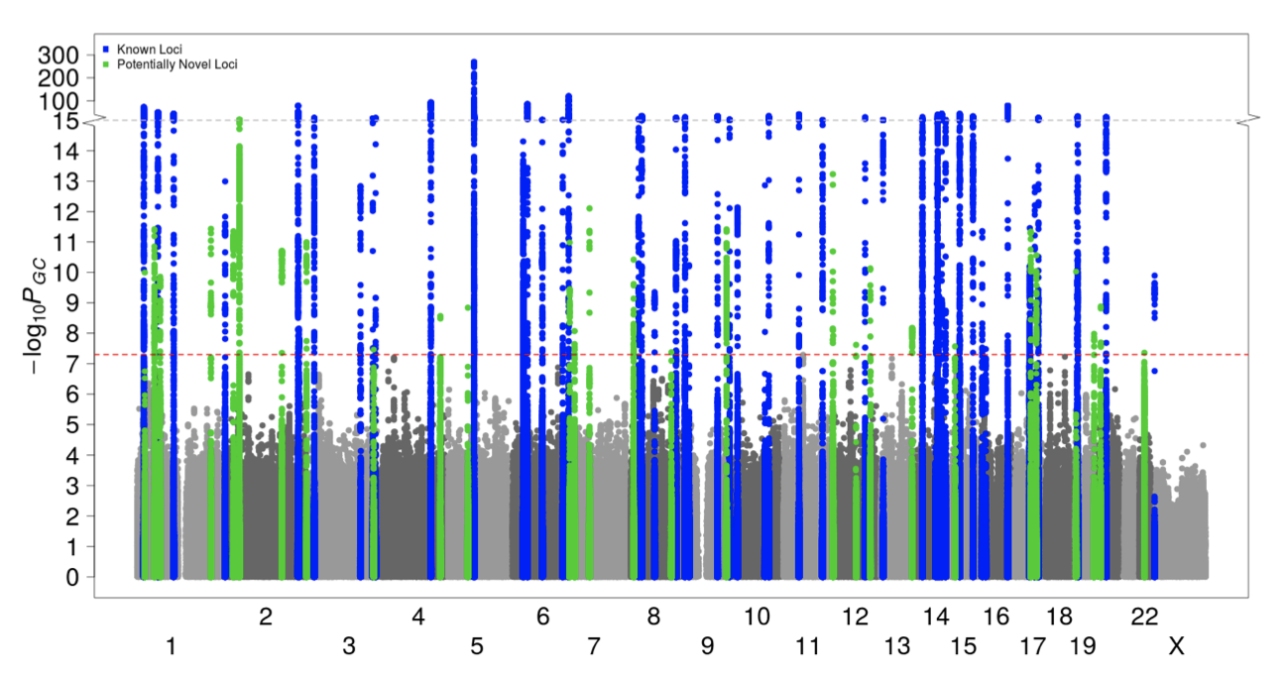
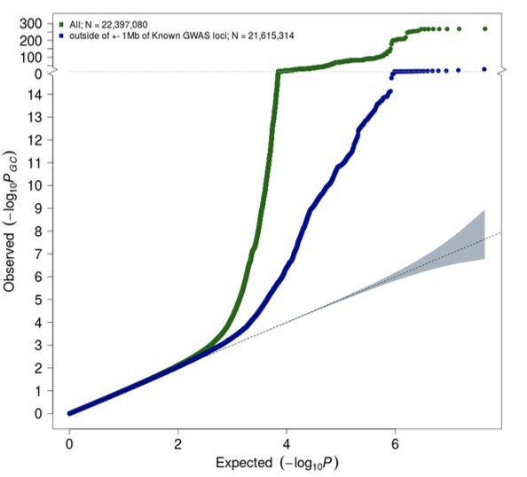
GWAS of TSH

Slide 23
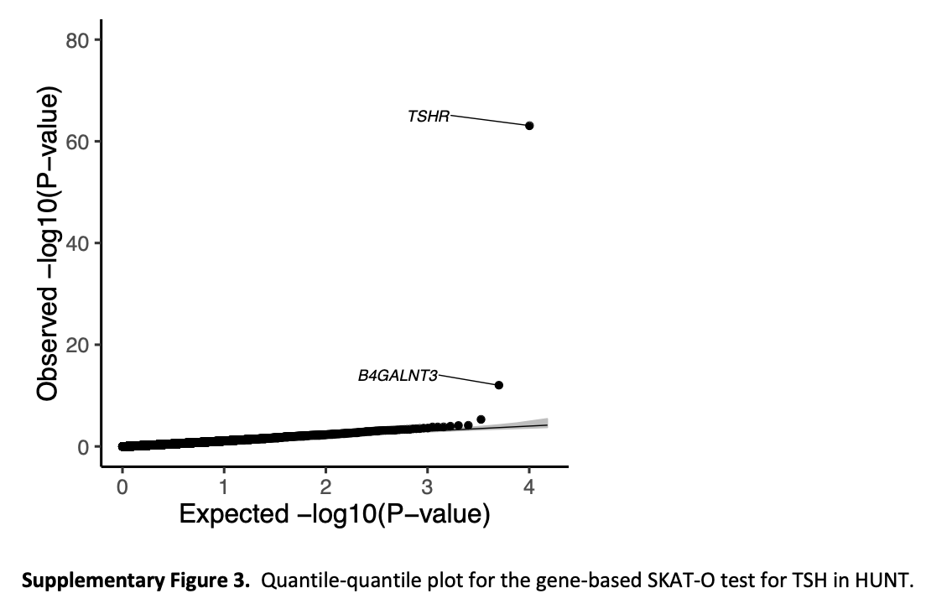
Gene-based burden test

Slide 24
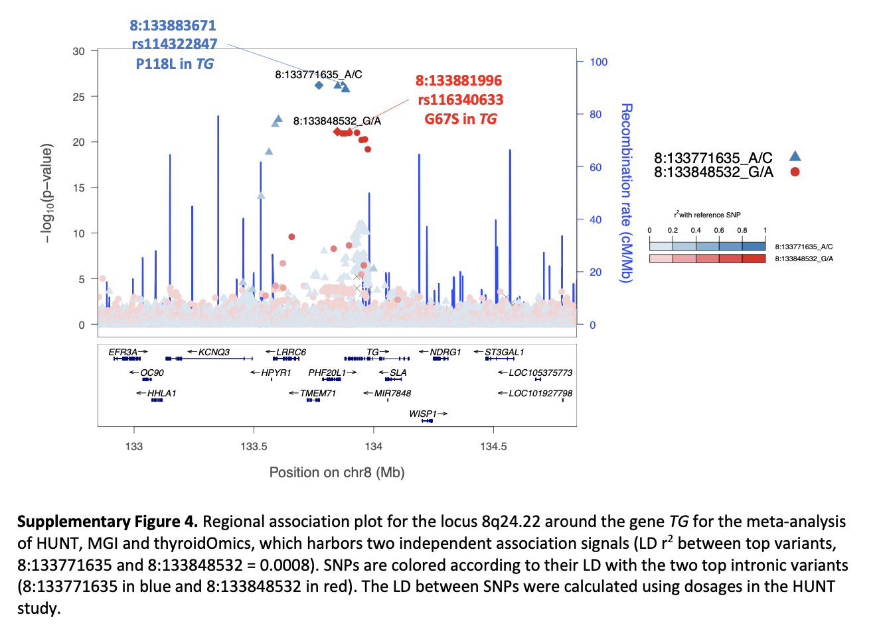
Fine-mapping an interesting locus (functional follow-up not shown here)
To identify potentially causal variants at TSH loci, we conducted fine-mapping using SuSiE⁴⁰, which estimates the number of causal variants and obtains credible sets of variants with 95% cumulative posterior probability through Iterative Bayesian Stepwise Selection…
…identified two association signals in the locus of the thyroglobulin gene (TG)

Slide 25
Prioritization/gene set analyses
Input: 161 GWAS loci with p < 1E-5 (as LD blocks)
Tissue associations:
None significant (Bonferroni or FDR)
Most significant: membranes, thyroid gland (as expected)
Gene prioritization:
“Based on functional similarity to other genes among TSH loci, 70 genes at the TSH-associated loci were prioritized by DEPICT with FDR ≤ 0.01” (including several novel associations)
Gene set analysis
“CTSD PPI subnetwork”
“regulation of phosphorylation”

Slide 26
PheWAS
95 top non-HLA variants
Test for association with 1283 diseases (phecodes) and 274 continuous traits in UKBB

Slide 27
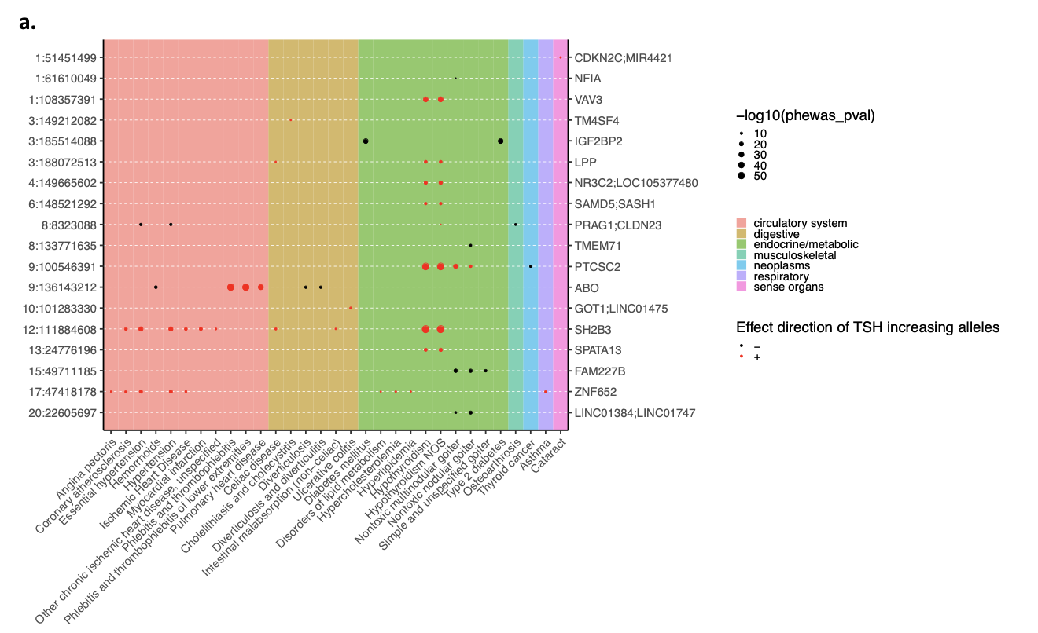
PheWAS
We identified significant (P-value < 5 × 10⁻⁸) pleiotropic association for 18 out of 95 non-HLA variants across 31 disease phenotypes including thyroid disorders, diabetes, cardiovascular disease, digestive system disorders, asthma, and cataracts

Slide 28
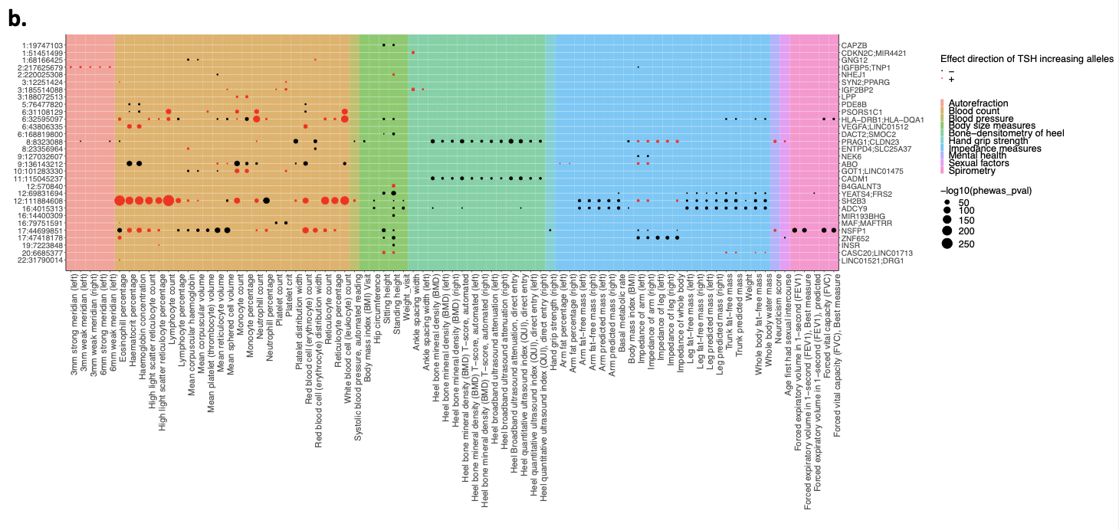
PheWAS
TSH-increasing alleles at one or more loci were associated with an increased risk of cardiovascular disease, smaller body size, reduced bone mineral density, decreased lung function, and an increased risk of hypothyroidism and a decreased risk of goiter. These results are generally consistent with previous studies
34 non-HLA variants were significantly associated (P-value < 5 × 10⁻⁸) with one or more quantitative traits, including body mass index, lung function measurements, metrics of bone density, spherical power/meridian measurements, and blood cell counts

Slide 29
PRS PheWAS
“Although individual TSH variants may exhibit pleiotropic effects, it is also possible that the cumulative effects of TSH-modifying genetic variants may lead to disease. Therefore, we constructed PGS from the 95 independent … and examined their association with the 1283 human diseases constructed from International Classification of Diseases (ICD) codes in the UKBB”

Slide 30
PRS PheWAS
The risk of thyroid cancer is lower for individuals with genetically predicted higher TSH levels.
Plots of thyroid cancer prevalence by quintiles of TSH PGS (left) and odds ratio of thyroid cancer in relation to the lowest quintile (right) in data sets UKBB (a; N case = 358, N control = 407,399), deCODE (b; N case = 1003, N control = 278,991)¹⁹, and FinnGen (c; N case = 501, N control = 135,137). N: sample size. N case: sample size of cases. N control: sample size of controls. Error bars represent 95% confidence intervals.

Slide 31
Mendelian randomization
“Two-sample Mendelian randomization using TSH index variants as instrumental variables suggests a protective effect of higher TSH levels (indicating lower thyroid function) on risk of thyroid cancer and goiter. Our findings highlight the pleiotropic effects of TSH-associated variants on thyroid function and growth of malignant and benign thyroid tumors.”

Slide 32
GWAS #3 Follow-up approach: A little annotation and MR
Bowden, S. J., Bodinier, B., Kalliala, I., Zuber, V., Vuckovic, D., Doulgeraki, T., Whitaker, M. D., Wielscher, M., Cartwright, R., Tsilidis, K. K., Bennett, P., Jarvelin, M. R., Flanagan, J. M., Chadeau-Hyam, M., Kyrgiou, M., & FinnGen consortium (2021). Genetic variation in cervical preinvasive and invasive disease: a genome-wide association study. The Lancet. Oncology, 22(4), 548–557. https://doi.org/10.1016/S1470-2045(21)00028-0
GWAS of cervical cancer (“broadly defined”); replication in FinnGen
Functional annotation
Mendelian randomization
What loci are associated with cervical cancer?
What do the variants do?
Can they be prioritized?
Can gene-environment interactions be inferred?

Slide 33
GWAS

Slide 34
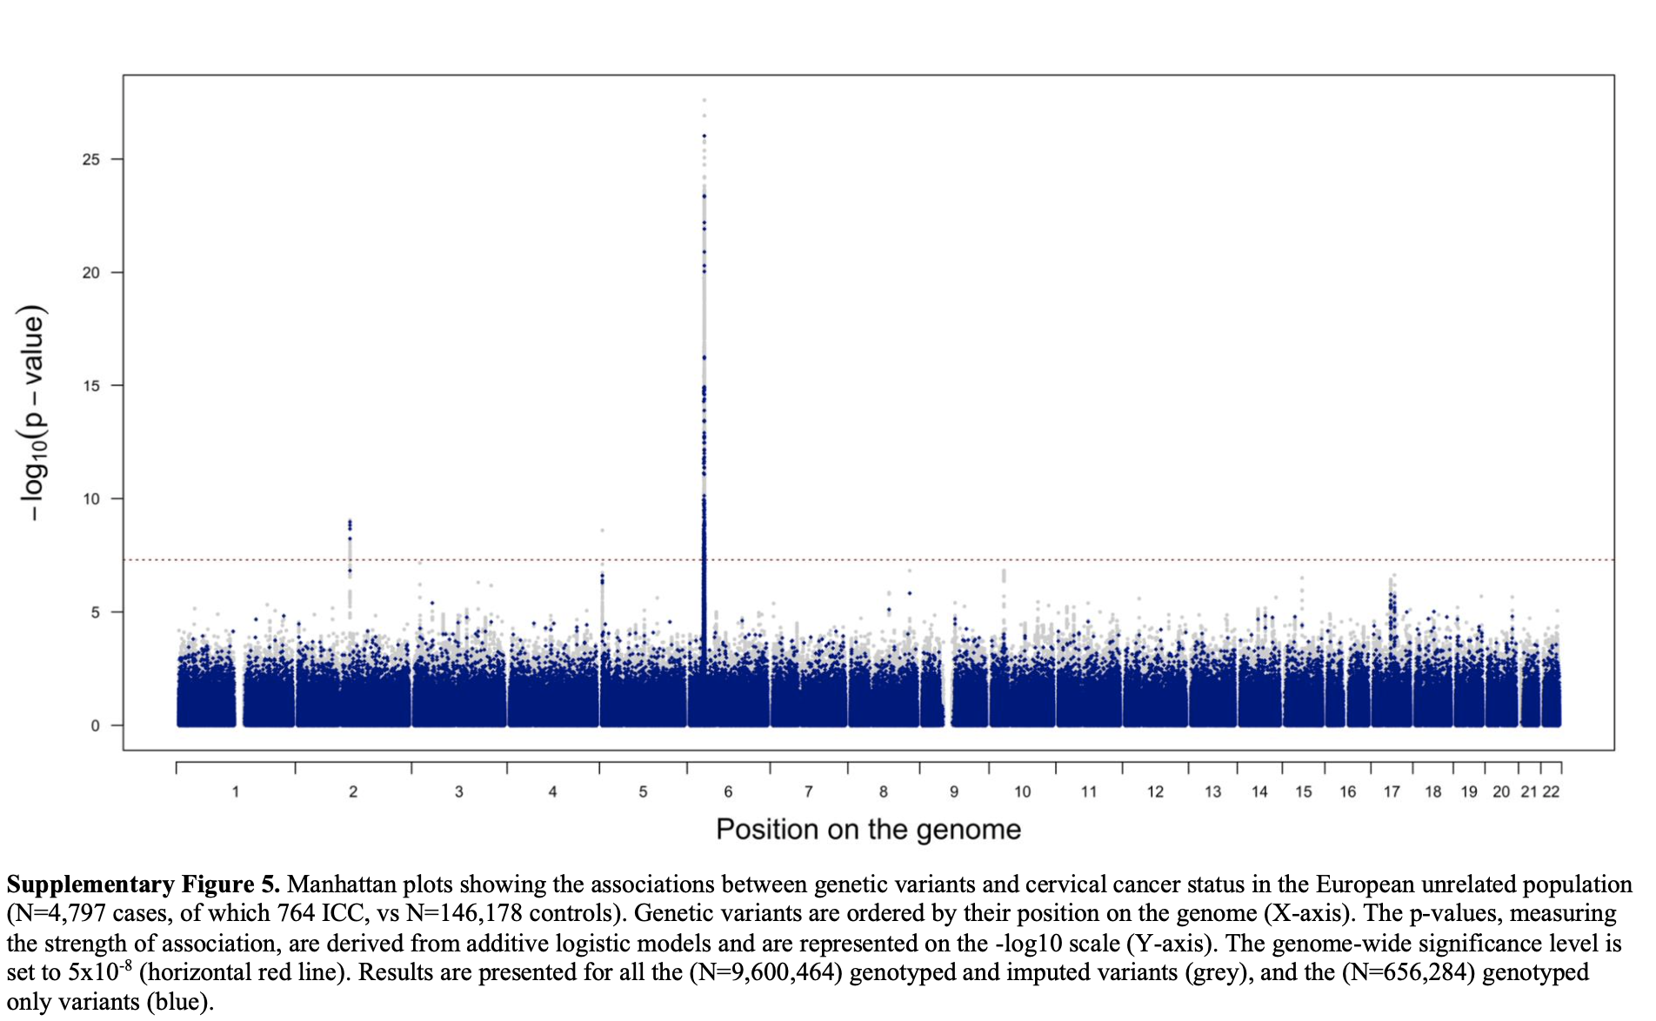
GWAS

Slide 35
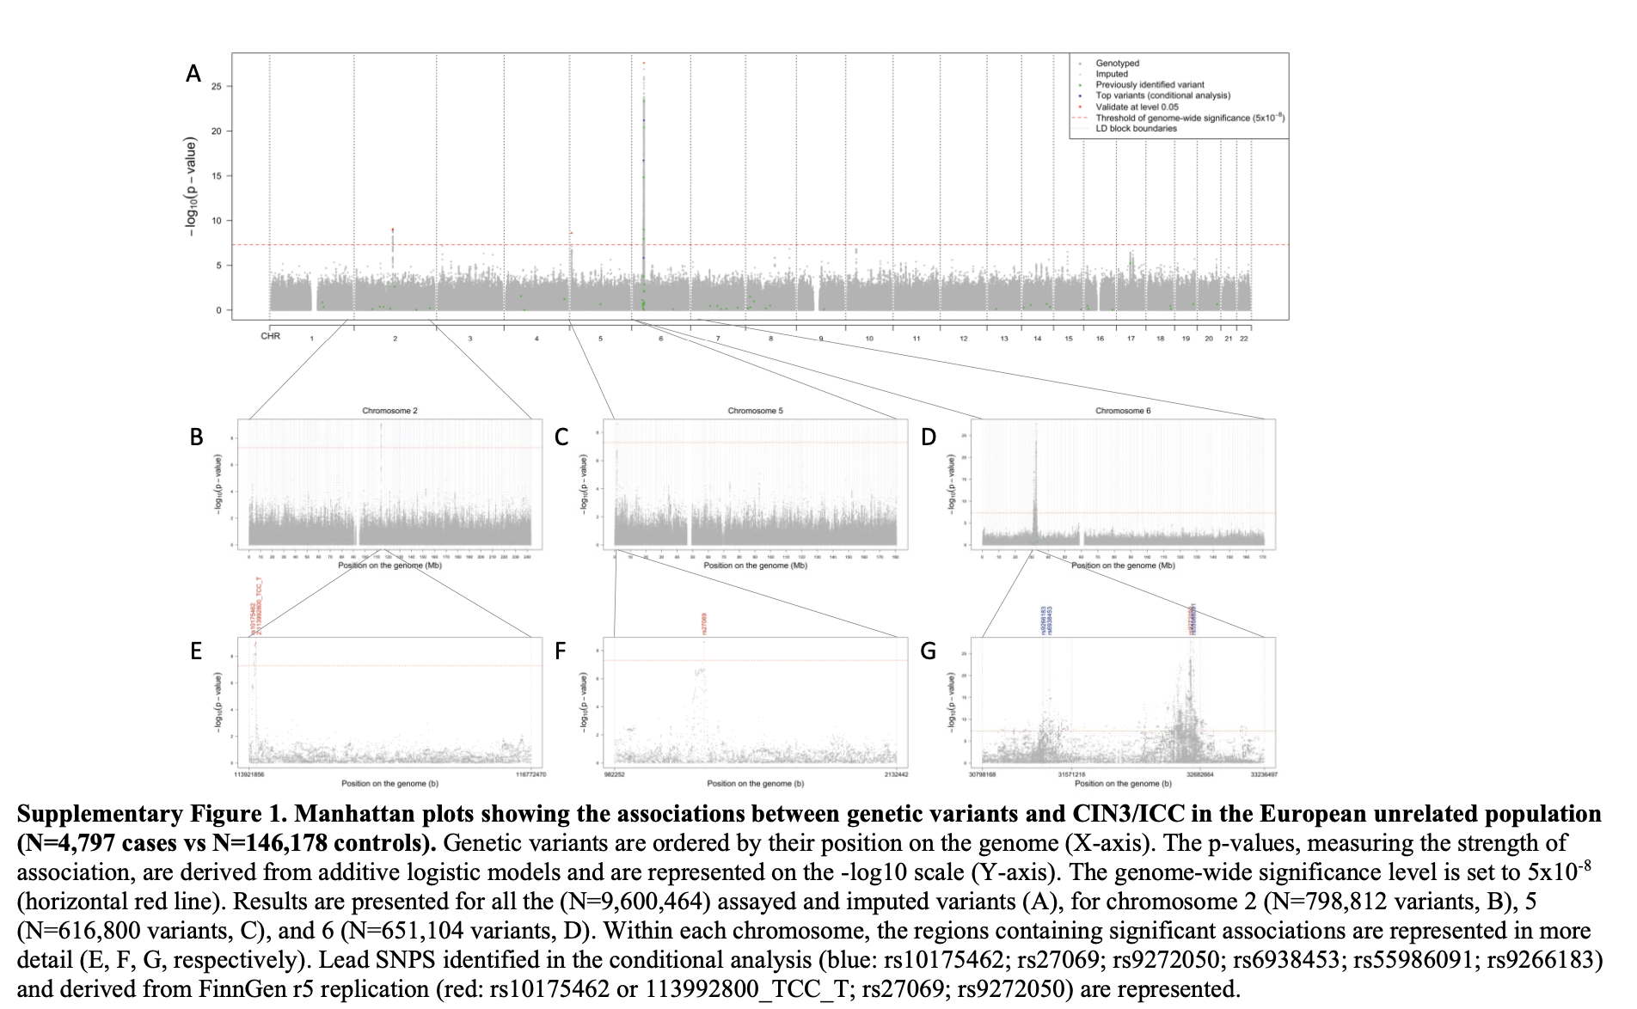
GWAS

Slide 36
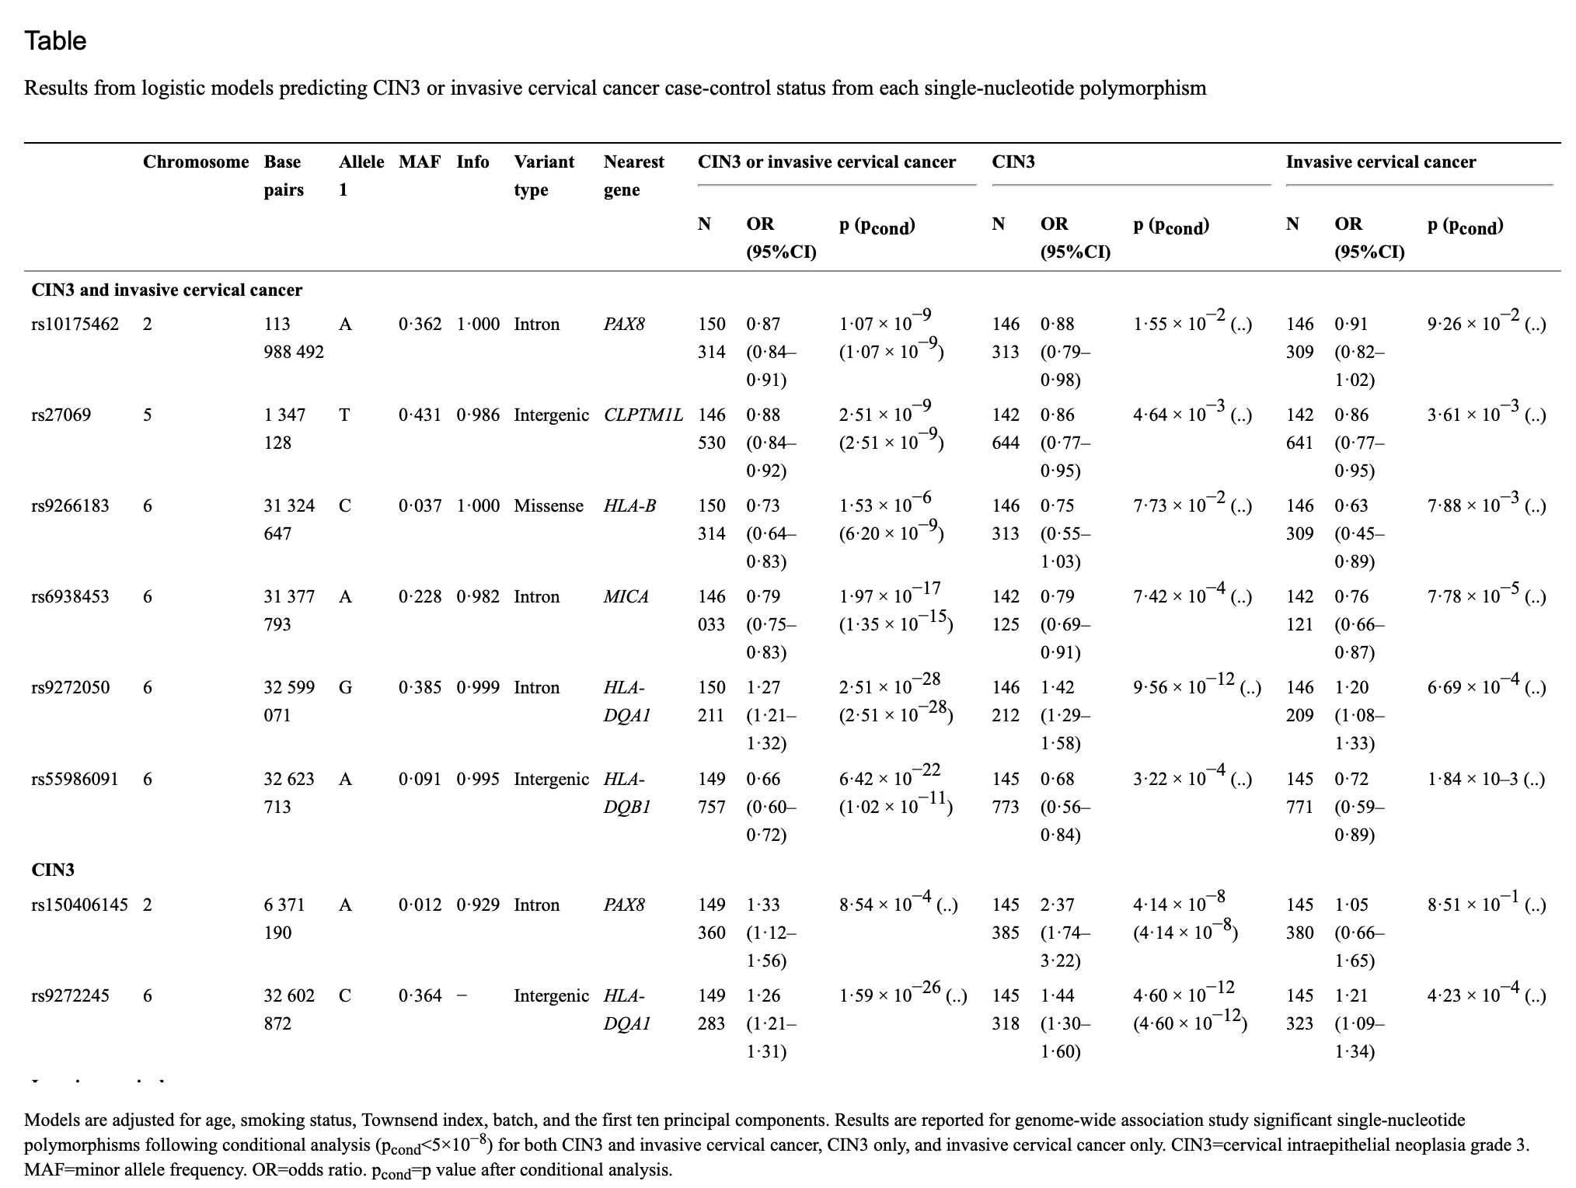
GWAS
Notes:
This table has been clipped

Slide 37
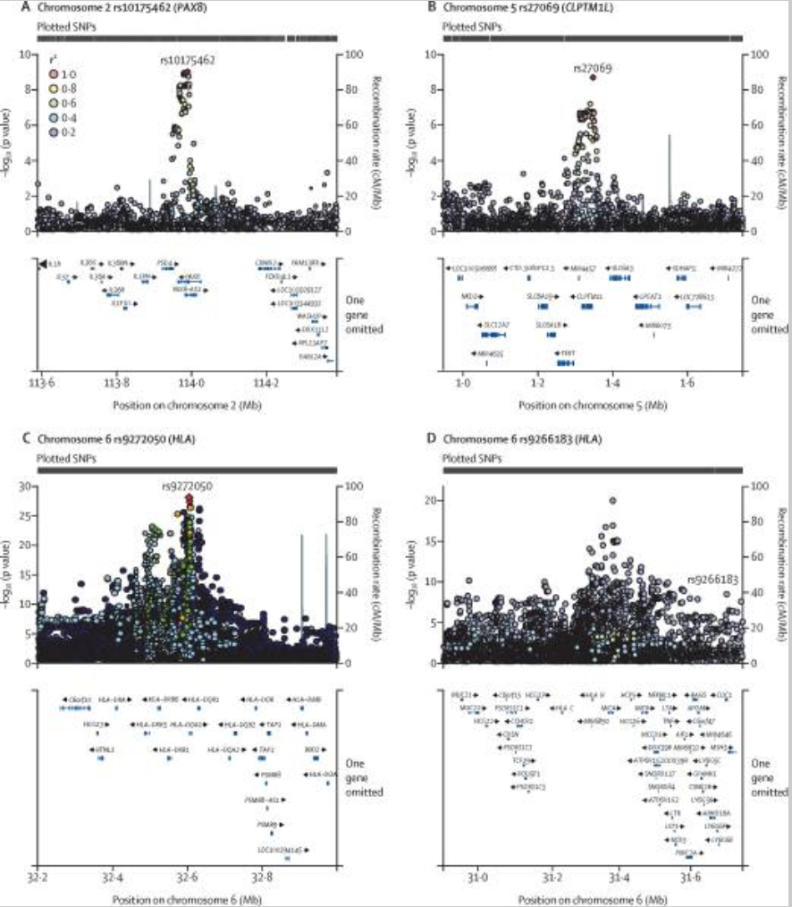
GWAS
3 main loci (some replicated in FinnGen)

Slide 38
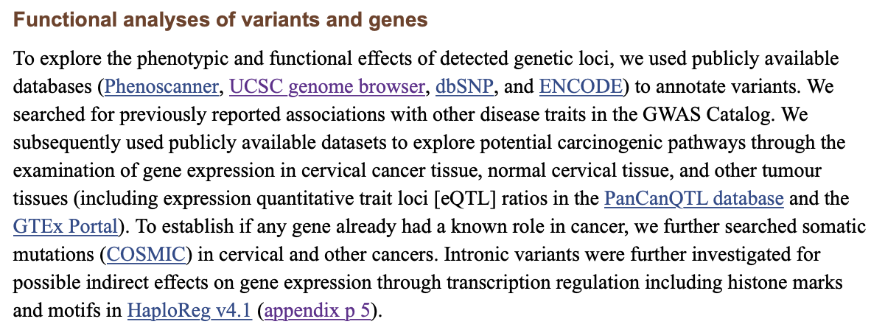
Functional annotation

Slide 39
Functional annotation

Slide 40
Functional annotation
Literature searches of genes/variants (some seen in prior GWAS of cervical cancer)
For HLA loci:
“Although we present four independent SNPS that have not been previously reported, linkage disequilibrium patterns from our analysis suggest high linkage with known variants.”
“Of interest is our novel report of the association at a rarer SNP rs9266183 (MAF 0.037; HLA-B), which represents a missense variant resulting in a codon shift and amino acid change. Alteration of this allele might result in a shift in peptide presentation properties, distorting the T-cell response to HPV infection.¹⁸ Owing to the lower MAF, this association has probably gone undetected in previous smaller studies. Despite the growing number of HLA associations reported for cervical cancer, minimal laboratory validation has been done; given an anticipated coding effect, rs926618 would be one of the most interesting targets for further functional analyses.”

Slide 41
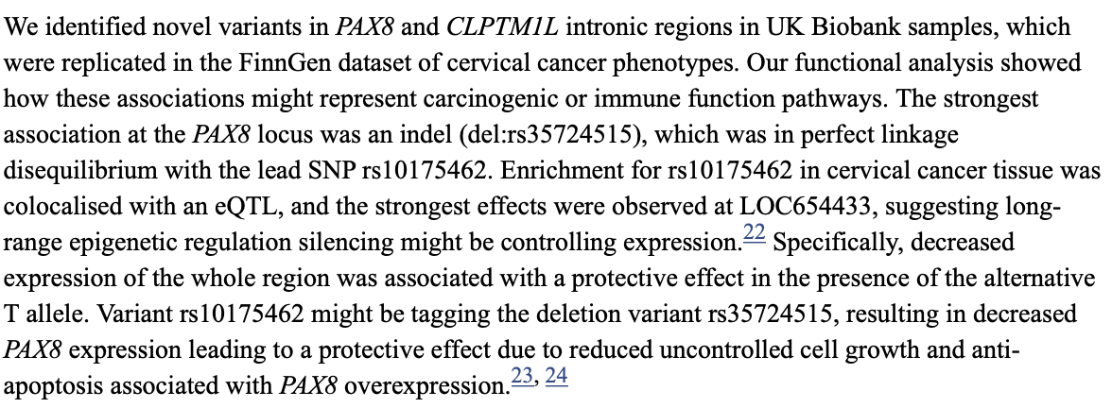
Functional annotation

Slide 42
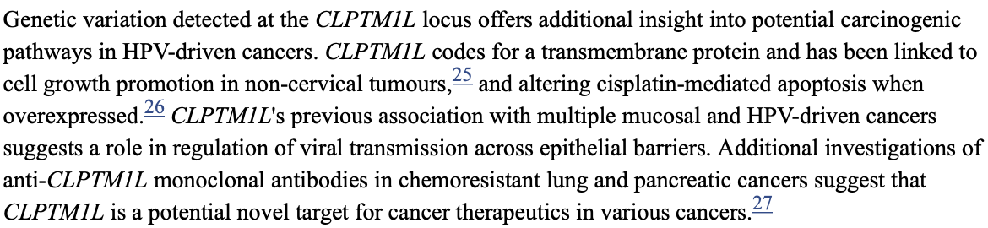
Functional annotation

Slide 43
Mendelian randomization
“[Two-sample] Mendelian randomisation further supported the complementary role of smoking (OR 2.46, 95% CI 1.64–3.69), older age at first pregnancy (0.80, 0.68–0.95), and number of sexual partners (1.95, 1.44–2.63) in the risk of developing cervical cancer.”

Slide 44
GWAS #4 Follow-up approach: Focus on phenotypes/expression in relevant tissues
Chen, V. L., Du, X., Chen, Y., Kuppa, A., Handelman, S. K., Vohnoutka, R. B., Peyser, P. A., Palmer, N. D., Bielak, L. F., Halligan, B., & Speliotes, E. K. (2021). Genome-wide association study of serum liver enzymes implicates diverse metabolic and liver pathology. Nature communications, 12(1), 816. https://doi.org/10.1038/s41467-020-20870-1
GWAS of liver enzyme levels in serum; meta-analysis
Gene, pathway, and tissue analysis
PheWAS (and secondary analyses)
Liver disease analysis
Single-cell transcriptomics
What loci are associated with enzyme levels?
What genes, pathways, tissues may be implicated?
What other traits are associated with the variants?
What (Mendelian) liver traits are associated with the variants?
Which exact cell types express the implicated genes?

Slide 45
GWAS
“Liver enzymes such as alanine transaminase (ALT), aspartate transaminase (AST), and alkaline phosphatase (ALP) are the most commonly-used laboratory indicators of liver disease and are increased in most common liver diseases”

Slide 46
GWAS
We defined/identified 172 independent ALT, 199 AST, and 216 ALP loci after eliminating any SNPs within 1 Mb or LD (R² > 0.01) of another genome-wide significant locus for the same trait
Genetic loci associated with liver enzymes A–C Circos plots depicting variants (unadjusted p < 5 × 10⁻⁸) with A alanine transaminase (ALT), B aspartate transaminase (AST), and C alkaline phosphatase (ALP). Outermost circles represent associations with ALT, middle AST, innermost ALP. D overlap of loci across traits. E Co-heritability of ALT, AST, and ALP. F Phenotypic correlation of ALT, AST, and ALP.
Notes:
Note that the authors also investigated heterogeneity between the two cohorts a bit.

Slide 47
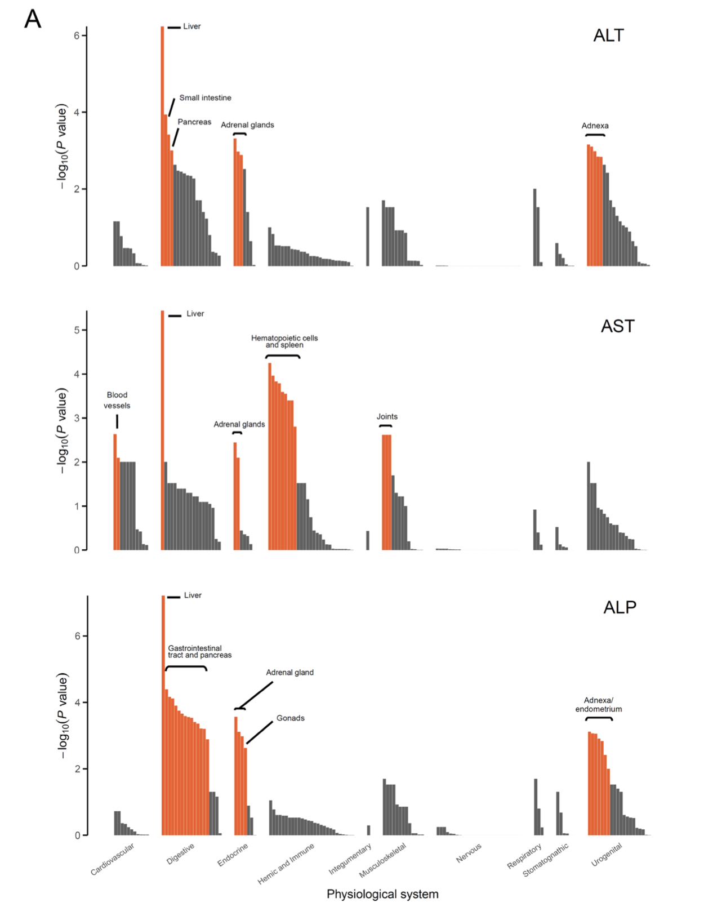
Gene, pathway, tissue analysis (DEPICT)
We used DEPICT, a program that uses GWAS-prioritized genes and gene co-expression patterns across cells and tissues, to identify tissues, pathways, and genes (using an FDR < 0.05) that are enriched for associations with a trait

Slide 48
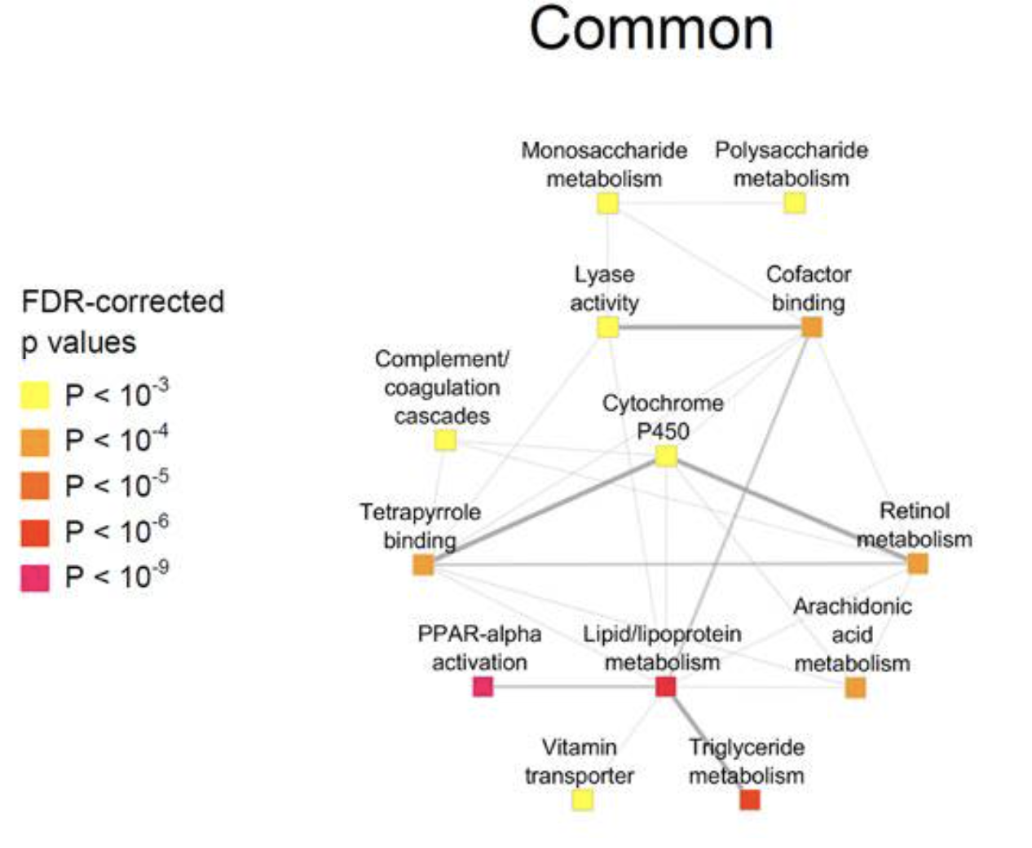
Gene, pathway, tissue analysis (DEPICT)
Network plots depicting gene sets enriched in all three sets of ALT-, AST-, and ALP-associated variants (“Common”)

Slide 49
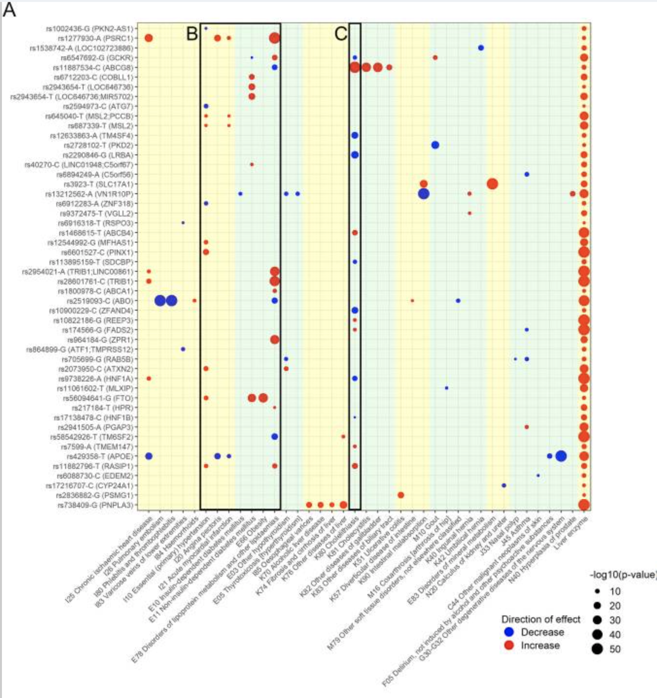
PheWAS
International Classification of Diseases (ICD)-based diseases using previously-published PheWAS data

Slide 50
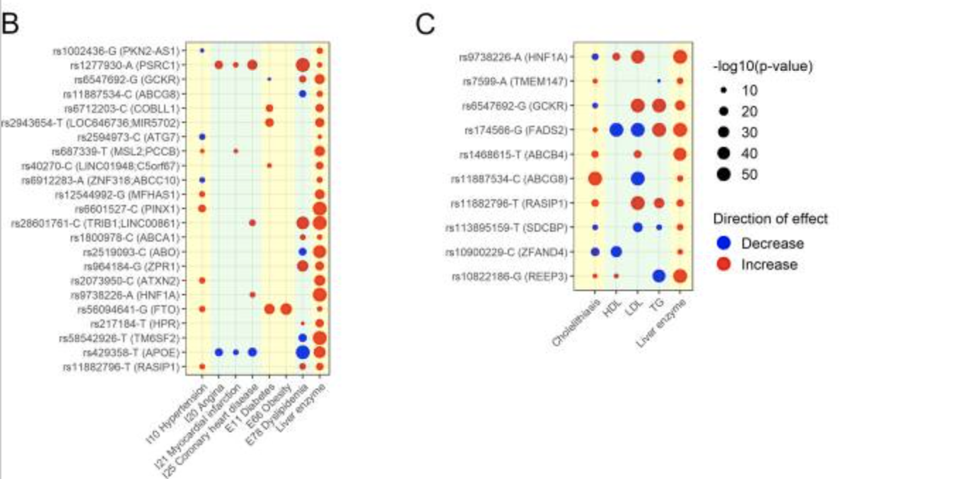
PheWAS
Notable findings were that a number of alleles were associated with metabolic diseases and cholelithiasis. 23 alleles associated with metabolic traits including hypertension, dyslipidemia, diabetes, and coronary artery disease (Fig. 4B). 13 alleles associated with variations in risk of cholelithiasis (Fig. 4C). Several alleles associated with other traits of interest: rs2836882 near PSMG1 associated with ulcerative colitis, multiple SNPs including rs3923 near SLC17A1 associated with disorders in mineral metabolism, and rs17216707 near CYP24A1 associated with nephrolithiasis.
Further analyses sought to disentangle causality in these associations:
“There was no significant evidence for causality of ALT, AST, or ALP with any metabolic traits. These analyses suggest that liver enzyme elevations themselves do not cause metabolic diseases, but instead are the result of metabolic disease such as obesity and dyslipidemia.”

Slide 51
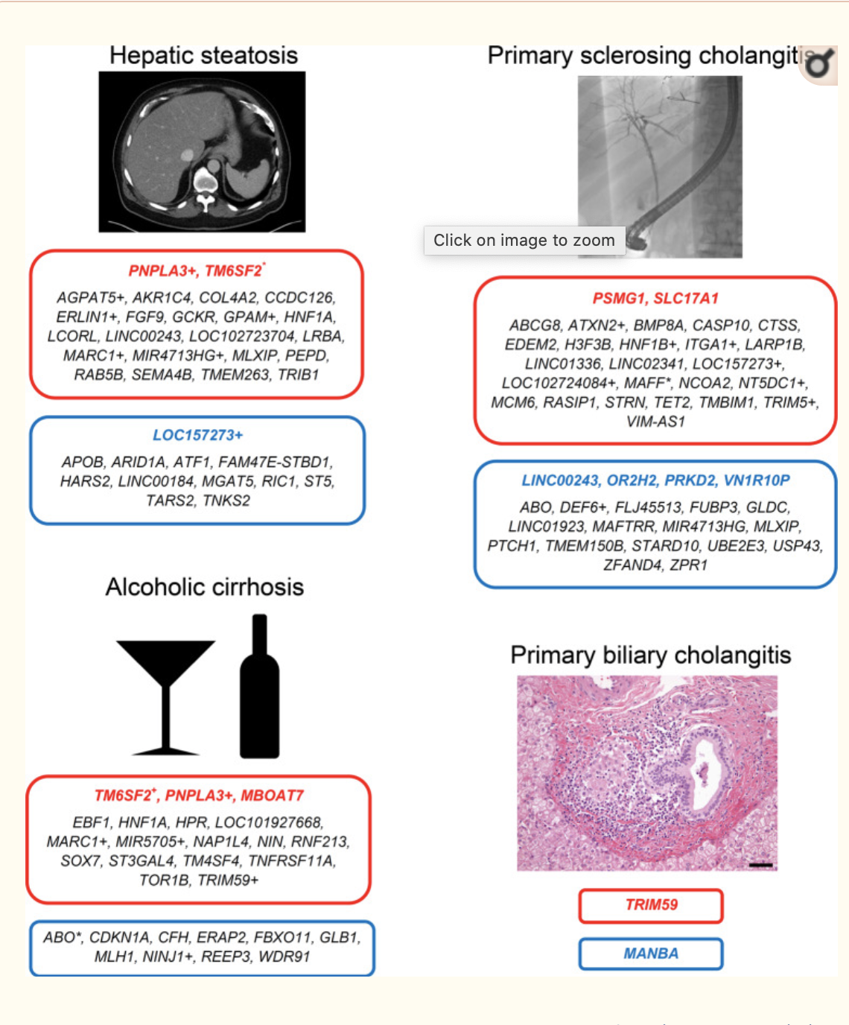
Overlap with previous liver disease GWAS
Associations of liver enzyme-increasing genetic variants on liver diseases. The nearest gene to each variant is depicted. Red text indicates that the liver enzyme-increasing allele increases risk of that disease, while blue text indicates that it lowers risk of that disease (Bonferroni-corrected). Black text indicates a trend toward a significant effect (p < 0.05). When two or three variants <1 MB apart are associated with different liver enzymes are also associated with a liver trait, this was considered a single genetic locus and the variant with the lowest p-value for its respective liver enzyme was used. These variants are highlighted with * indicating that the locus had opposite directions of association on the liver enzymes, or with + indicating that the locus had the same direction of association on the liver enzymes. Hepatic steatosis is defined as negative computed tomography-measured liver attenuation, so that an allele that is associated with increased liver attenuation would be associated with decreased hepatic steatosis, and vice versa.

Slide 52
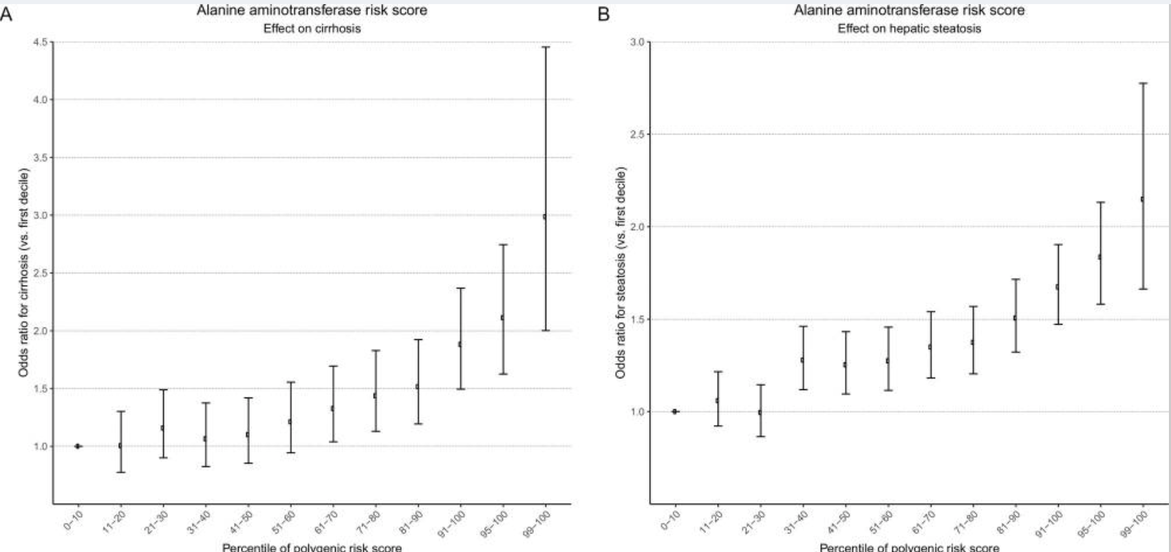
PRS

Slide 53
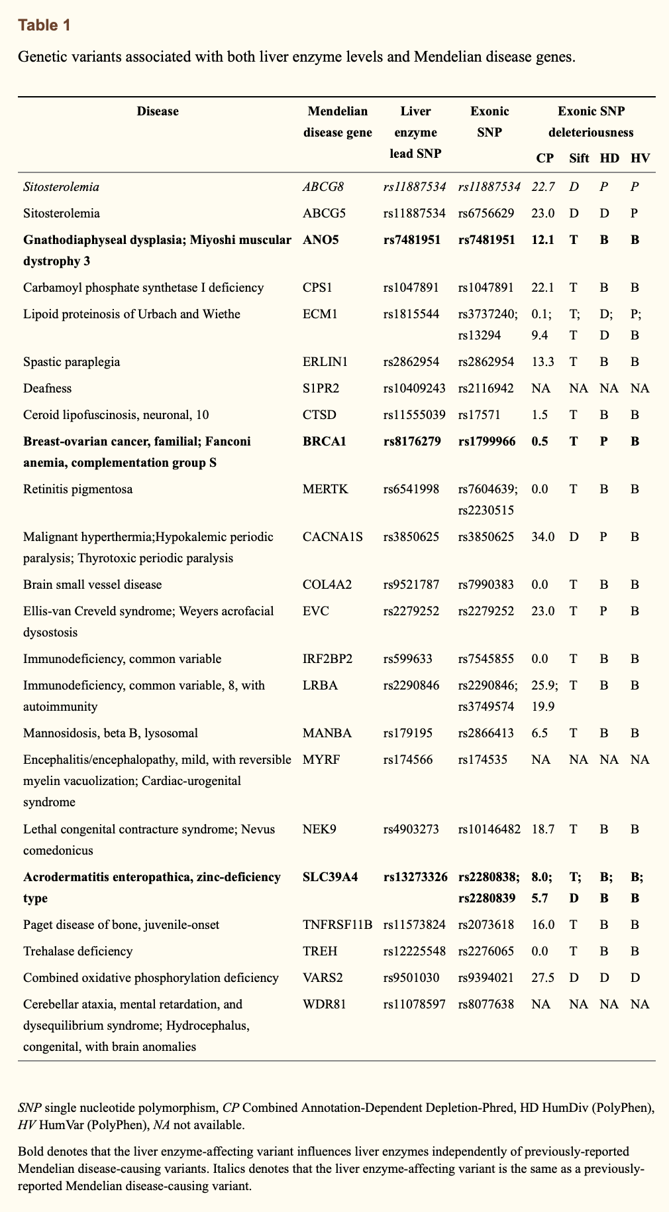
Overlap with Mendelian disease
Next, we investigated associations between non-synonymous mutations in LD with the liver enzyme-associated variants and Mendelian diseases using the Online Mendelian Inheritance in Man catalog
“…Other potentially deleterious missense mutations in LD with ALT-increasing alleles were found in ANO5, which is associated with Miyoshi muscular dystrophy; the breast/ovarian cancer susceptibility gene BRCA1; and LRBA, associated with common variable immunodeficiency. These LD exonic alleles were associated with abnormal liver enzymes even after adjustment for previously-reported Mendelian disease variants and constitute new physiology-altering if not disease-causing variants.”

Slide 54
Single-cell RNA-seq
Finally, we used recently-reported human single cell RNA sequencing data from human liver to investigate cell-specific expression of the genes nearest to the liver enzyme-altering variants
“Combining single cell sequencing and GWAS may suggest mechanisms by which a specific variant affects liver disease. For example, TM6SF2 was expressed exclusively in hepatocytes, consistent with its reported effect on very low-density lipoprotein export in hepatocytes³⁶. PNPLA3, in contrast, was expressed at high levels in both hepatocytes and cholangiocytes compared to other cell types.”
Cell type-specific expression of genes nearest to selected liver enzyme-associated genetic variants Gene names appear in the boxes corresponding to the cell type in which they are specifically expressed.

Slide 55
GWAS #5 Follow-up approach: “Do a lot of stuff and informally integrate it all”
Gharahkhani, P., Jorgenson, E., Hysi, P., Khawaja, A. P., Pendergrass, S., Han, X., Ong, J. S., Hewitt, A. W., Segrè, A. V., Rouhana, J. M., Hamel, A. R., Igo, R. P., Jr, Choquet, H., Qassim, A., Josyula, N. S., Cooke Bailey, J. N., Bonnemaijer, P., Iglesias, A., Siggs, O. M., Young, T. L., … Wiggs, J. L. (2021). Genome-wide meta-analysis identifies 127 open-angle glaucoma loci with consistent effect across ancestries. Nature communications, 12(1), 1258. https://doi.org/10.1038/s41467-020-20851-4
GWAS and meta-analysis of primary open-angle glaucoma (POAG)
Cross-ancestry fine-mapping (PAINTOR)
Gene-based and pathway analyses (MAGMA)
Functional annotation/gene-mapping
TWAS and expression
Drug targets
(Open Targets)
What loci are associated with glaucoma?
Can variants at each locus be prioritized (by combining LD across analysis groups)?
What genes are associated? Do genes from certain categories contribute more to glaucoma?
What genes can be prioritized at each locus? What are the variants’ effects? (FUMA)
Which loci might be involved with glaucoma by modulating gene expression?
Do any drugs target the implicated genes in treating any (ocular) disease?

Slide 56
GWAS #5

Slide 57
GWAS
Manhattan plots for the cross-ancestry meta-analysis.

Slide 58
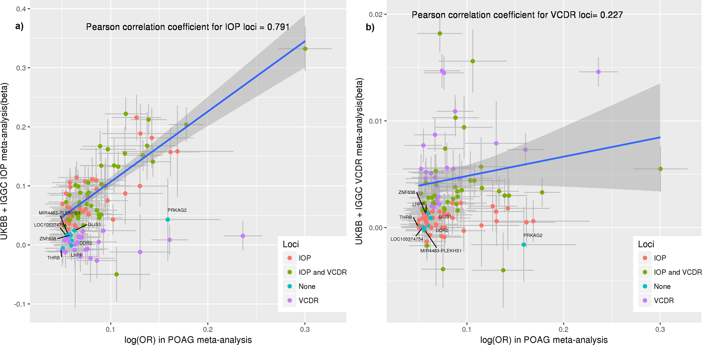
“Pleiotropy”
“Several highly heritable endophenotypes are related to POAG risk including IOP, structural variation of the optic nerve characterized as vertical cup-to-disc ratio (VCDR) and variation in thickness of the retina cell layers including the retinal nerve fiber layer (RNFL) and the ganglion cell inner plexiform layer (GCIPL)”
“All POAG risk variants identified to date have also been associated with either IOP or with VCDR or both. We investigated the association of the POAG loci identified in this study with IOP and VCDR, using previous GWAS data .”
→ “Most of the risk loci associated with POAG involve known glaucoma-related endophenotypes”

Slide 59
Colocalization
“Given that three POAG risk loci that we identified (loci containing MAPT, CADM2, and APP) have also been implicated in Alzheimer’s disease (AD) and dementia^{26,27,28}, we asked whether the same causal variants may underlie these loci and whether there is evidence for genetic sharing in any of the other genome-wide significant POAG loci. Applying the Bayesian-based colocalization method, eCAVIAR²⁹, to the cross-ancestry and European POAG GWAS meta-analyses and the publicly available AD GWAS data³⁰ for 21,982 cases and 41,944 controls³⁰ of European descent, we found no evidence for sharing of causal variants in the 123 (cross-ancestry) or 66 (European) autosomal POAG loci (Colocalization Posterior Probability (CLPP) < 0.01; Supplementary Data 7).”

Slide 60
Fine-mapping
“Overall, the best causal SNPs in Europeans changed for 52 of 127 loci after including data from the other ancestries ”

Slide 61
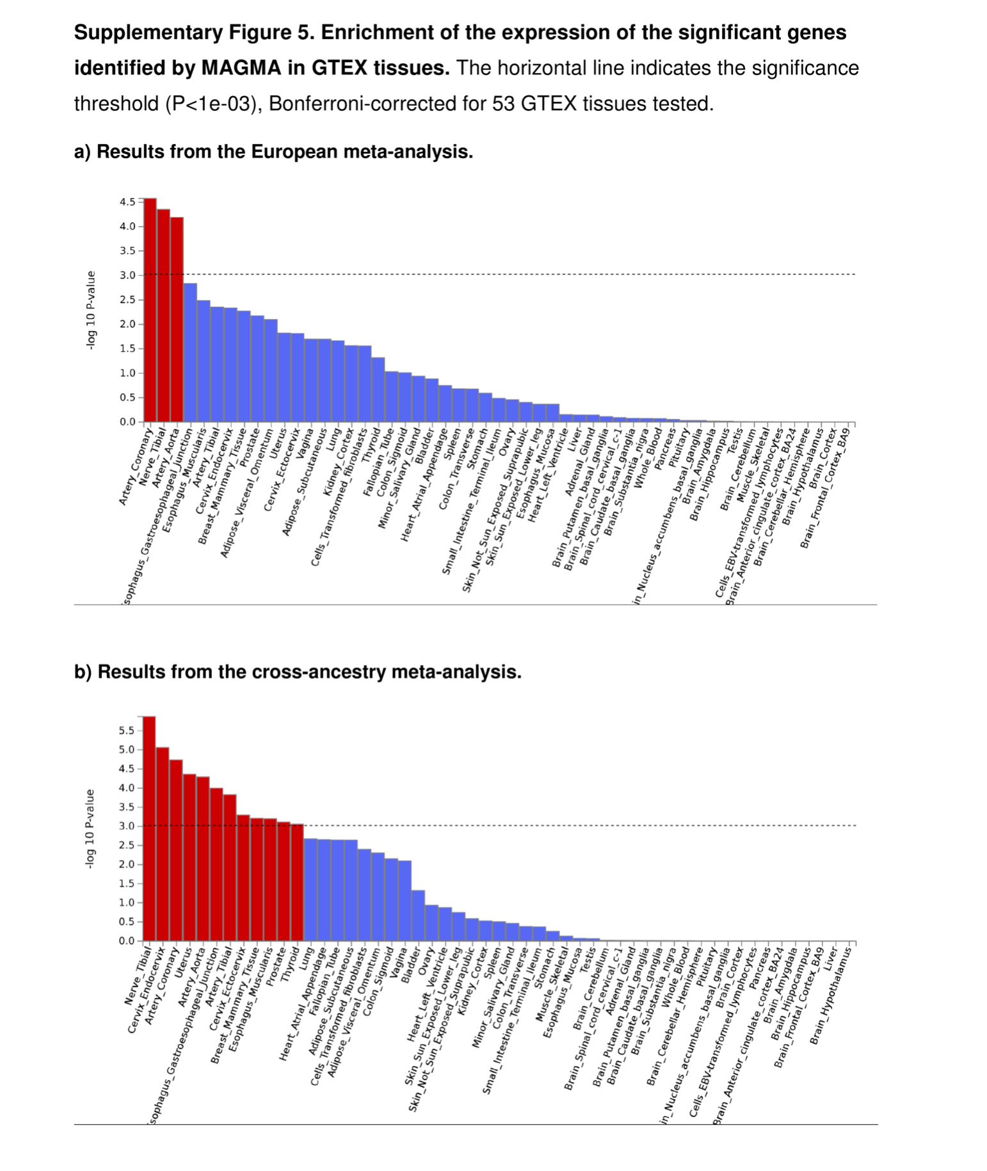
Gene-based and pathway analyses (MAGMA)
Expression of the risk genes identified in MAGMA gene-based analysis were significantly enriched in artery and nerve tissues, reflecting the widely recognized neuronal and vascular character of glaucoma
Pathway analysis identified 21 significant gene-sets surviving the Bonferroni-corrected threshold (P < 0.05/10678). These included previously identified pathways such as collagen formation and vascular development, and highlighted additional pathways involved in lipid binding and transportation such as apolipoprotein binding and negative regulation of lipid storage

Slide 62
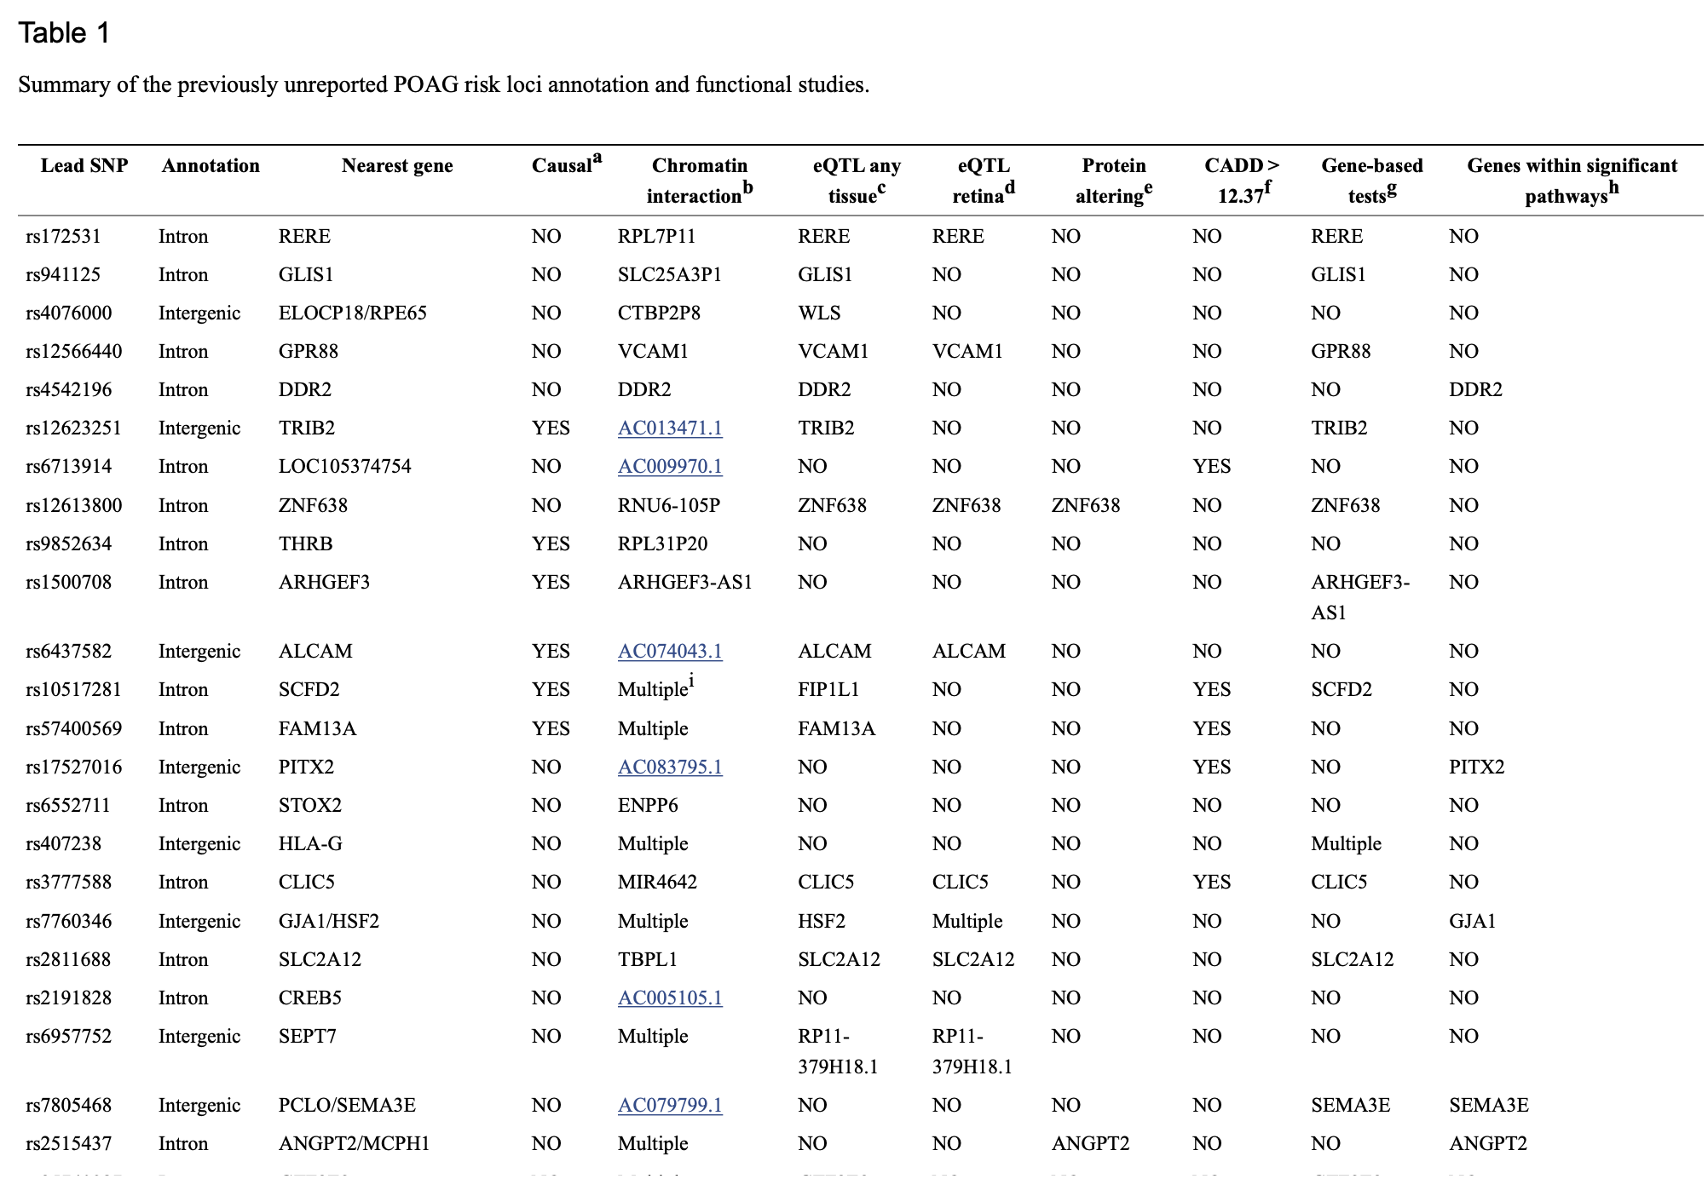
Functional annotation/gene-mapping
ªThis column indicates whether the GWAS lead SNP was identified to be the most probable causal SNP across ancestries in the multi-ethnic fine-mapping analyses performed using the software PAINTOR.
^{b}Where the GWAS lead SNP or SNPs in LD r² > 0.8 with the lead SNP overlap with one end of a chromatin interaction, the most significant gene involved in this interaction has been shown.
^{c}Where the GWAS lead SNP or SNPs in LD r² > 0.8 with the lead SNP is an eQTL in any GTEx tissue or the other eQTL databases used in this study (see the Methods), the most significant target gene has been shown.
^{d}Where the GWAS lead SNP or SNPs in LD r² > 0.8 with the lead SNP is an eQLT in retina in EyeGEx study, the most significant target gene has been shown.
^{e}Where the GWAS lead SNP is a protein-altering variant or in LD r² > 0.8 with a protein-altering variant, the corresponding gene has been shown.
^{f}This column indicates whether the GWAS lead SNP has a CADD score > 12.37.
^{g}This column shows the loci in which one or multiple genes were significant in any of the gene-based tests (MAGMA, MetaXcan, SMR, and FOCUS) used in this study. “Multiple” indicates that several genes are involved. These genes have been named in Supplementary Data ¹⁴.
^{h}This column shows the loci for which the reported nearest genes or the significant genes identified in the gene-based tests above are members of at least one significant POAG pathway identified in this study.
^{i}“Multiple” indicates several genes.

Slide 63
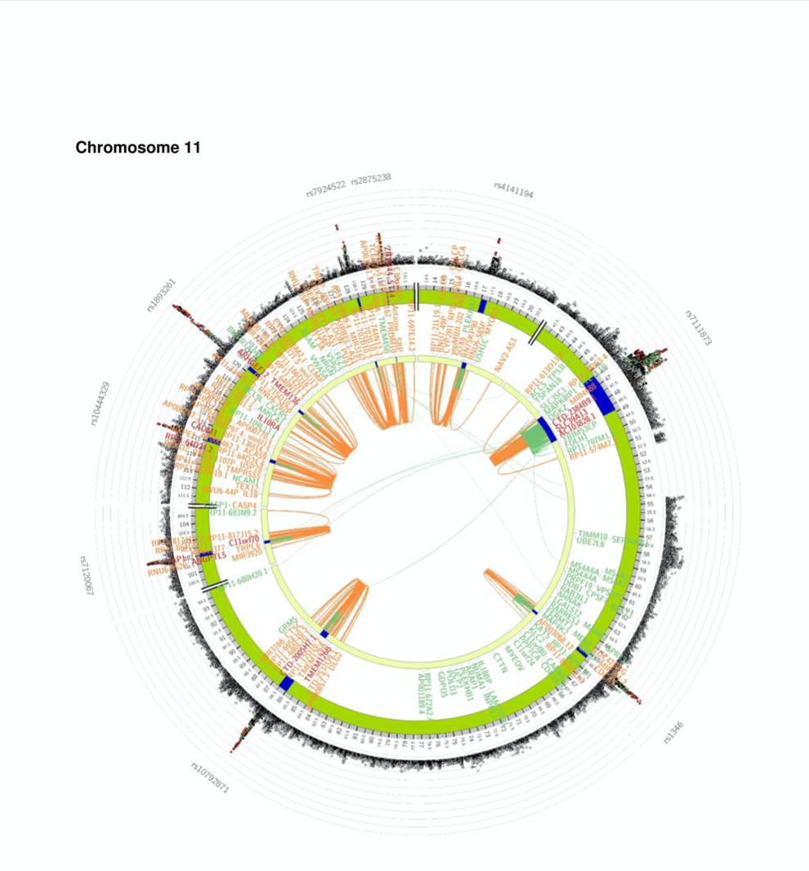
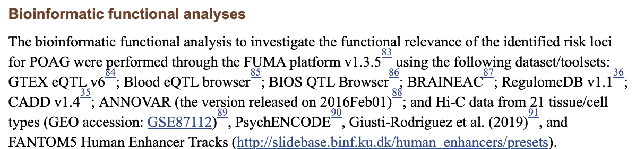
Functional annotation/gene-mapping

Slide 64
TWAS
Two approaches
MetaXcan
“we used our POAG cross-ancestry meta-analysis statistics, RNA-seq and genotype data from peripheral retina (EyeGEx) and 44 GTEX tissues”
“we identified 100 significant genes, which were selected as the most likely causal genes based on the integration of eQTL data”
Summary Mendelian randomization
“we integrated our GWAS meta-analysis summary statistics with eQTL data from blood and retina”
“Although the majority of the risk loci identified through the MetaXcan and SMR approaches were also identified in the meta-analysis, these analyses help with prioritizing the most likely functionally relevant genes”
“we used the approach implemented in FOCUS v0.5, a probabilistic framework that assigns a posterior probability for each gene causally driving TWAS associations in multiple tissues”

Slide 65
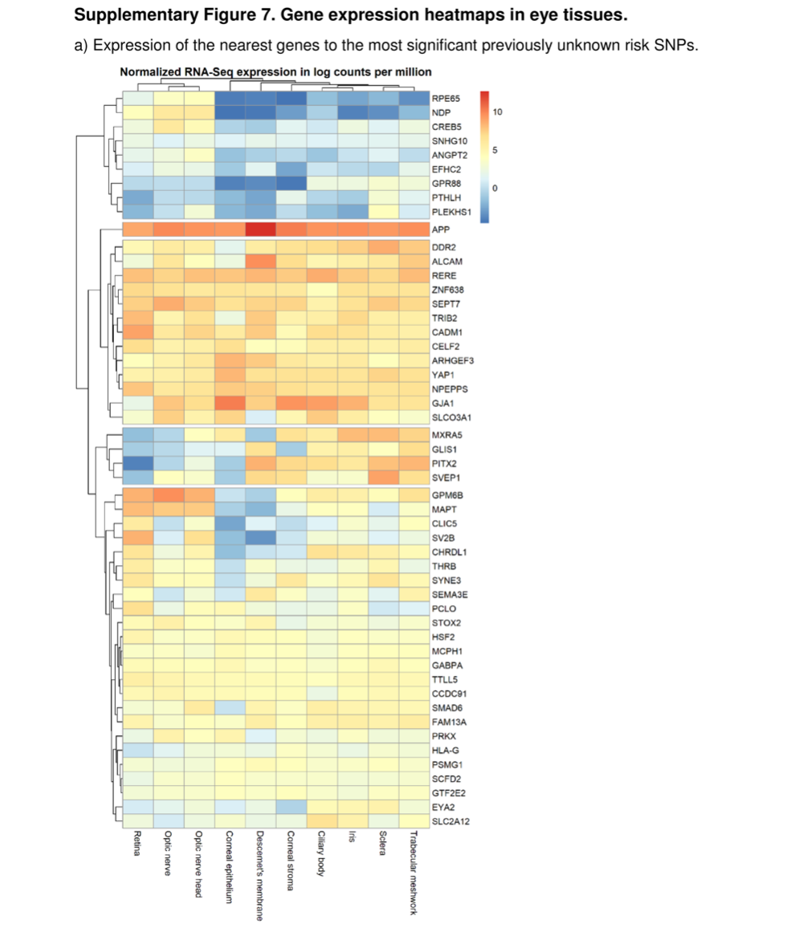
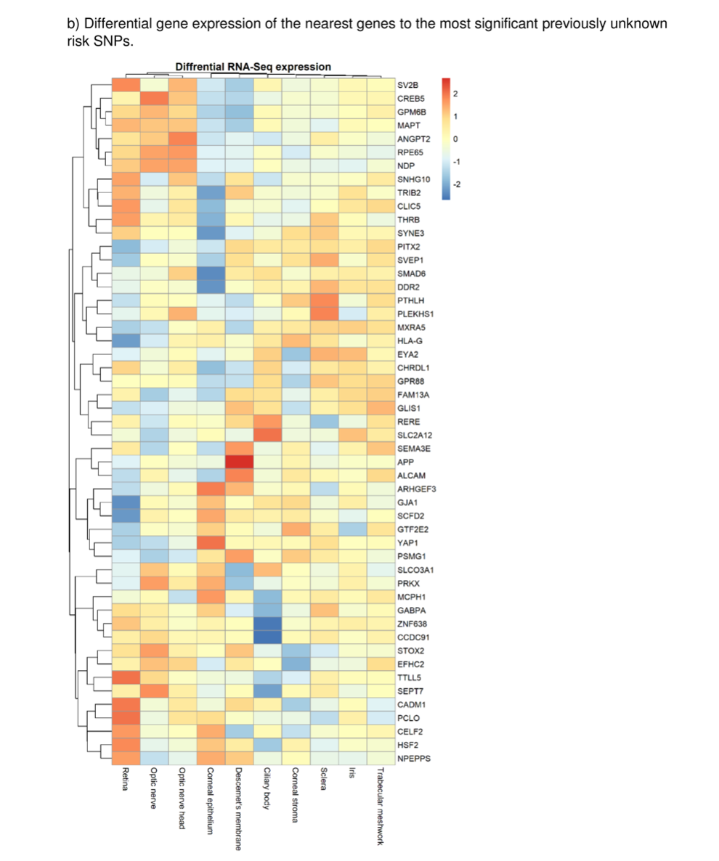
Differential expression of the previously unknown risk loci in eye tissues
We examined the differential expression of the previously unreported genes in ocular tissues likely to be involved in POAG pathogenesis, namely trabecular meshwork, ciliary body and optic nerve head, and found 36/51 (71%) of the genes differentially expressed in these tissues compared to the other eye tissues tested in this study
Clustering analysis shows that the majority of these genes were expressed in eye tissues

Slide 66
Drug targets (Open Targets)
“At least 16 of the POAG risk genes (nearest to the lead SNPs) are targeted by existing drugs, some of which are already in use/clinical trials for several eye or systemic diseases. The functional relevance of 14 of these 16 drug target genes is supported by the bioinformatic functional analyses we used in this study (i.e., eQTL, chromatin interaction, etc; Supplementary Data ”

Slide 67
Summary
“Integrating data from several lines of evidence described above, as well as the cross-ancestry fine-mapping and genetic pathways, provided support for specific genes potentially influencing POAG risk particularly RERE, VCAM1, ZNF638, CLIC5, SLC2A12, YAP1, MXRA5, and SMAD6.”
“For example, rs3777588, a lead GWAS SNP in this study, is an intronic variant within CLIC5. The CADD score for this variant is 16.58, providing support for the pathogenicity of this variant (determined by a CADD score > 12.37). The lead SNP is also an eQLTL for CLIC5 in both GTEx and retina, and gene-based analysis by incorporating eQTL data supported the involvement of CLIC5 in POAG risk.”
“This approach also helped to select best genes near the lead SNPs or to shift the focus from the nearest genes to genes further away. For example, rs12846405, a lead GWAS SNP in this study, is an intergenic variant located between MXRA5 and PRKX. Based on integration of eQTL data and gene-based analysis, MXRA5 was prioritized as the most likely causal gene in this locus.”

